Slide 1
Promoting Healthier Choices Simple changes to help your pantry and clients make healthy foods the focus
Presented by: Amy Wilson, Community Nutrition Manager
with: Debra Mimaroglu, Nutrition Educator
Beth Seeley, Community Nutrition Educator

Slide 2
What will we talk about today?
Brief overview of what is considered a ‘healthy food’
How subtle changes/cues can affect our decisions
Pantry Profiles
Foods promoted
Strategies
Before and After photos

Slide 3
Fruits & Vegetables | Grains | Protein | Dairy
Fresh Produce | Whole Grains | Nuts, seeds | 1% or skim milk
Canned- low sodium or in juice | 100% or first ingredient noted as ‘whole’ | Beans, lentils | Low fat cheese, yogurt
Frozen- no sauces | Brown rice Whole wheat bread or pasta | Lean meats- breast, loin, 85/15 or 90/10 | Unsweetened milk substitutes
Notes:
Foods to encourage/based off of myplate as well

Slide 4
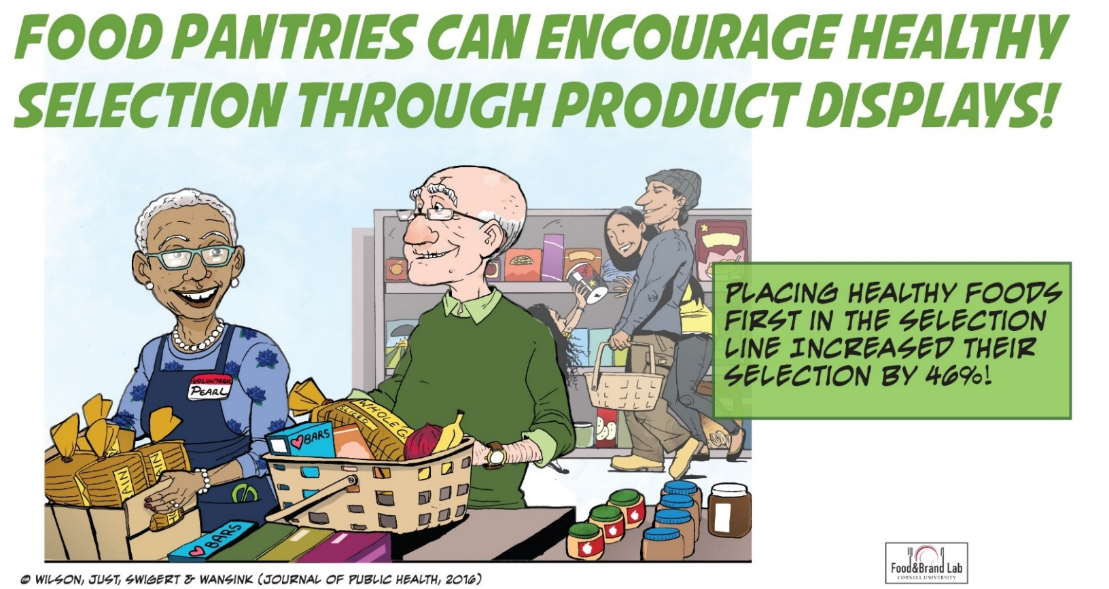
Nudges to Influence Healthy Choices
https://youtu.be/aJmgN5wavNY

Slide 5
Healthy Pantry Initiative
Selected three pantries
One nutrition educator assigned to each pantry
Completed assessment
Baseline photos
Discussed what foods to focus on
Decided on the most feasible changes to make

Slide 6
Layout
&
Signage
Inventory
& Promotion
Pantry Engagement
&
Culture

Slide 7
P A N T R Y A P R O F I L E
Location: | Syracuse, Onondaga County
Approx. # HH served monthly: | 200 Serves a diverse population
Layout & Signage: | Healthy foods clearly displayed Written materials, posters though out pantry No signage for specific foods Foods set up on tables
Inventory & Promotion: | Fresh produce usually available Hosted nutrition education sessions Recipes available in the past
Pantry Engagement & Culture: | Tables well organized Consistent volunteers Volunteers interact with guests
Foods selected to focus on: | Dried beans & dried lentils
Notes:
High poverty >30%

Slide 8
P A N T R Y A S T R A T E G I E S
Layout & Signage: | Create signage specifically promoting lentils and dried beans—use chalkboard signs Include a photograph of food on sign Provide preparation tips & recipes
Inventory & Promotion: | Highlight healthy foods on tables Consistently offer a sufficient amount of healthy food options Remind pantry of availability of fresh produce from FBCNY
Pantry Engagement & Culture: | Pantry and pantry volunteers assist with set up Share recipes with guests Debra led a nutrition workshop for guests Provided samples of a delicious recipe using lentils and beans

Slide 9
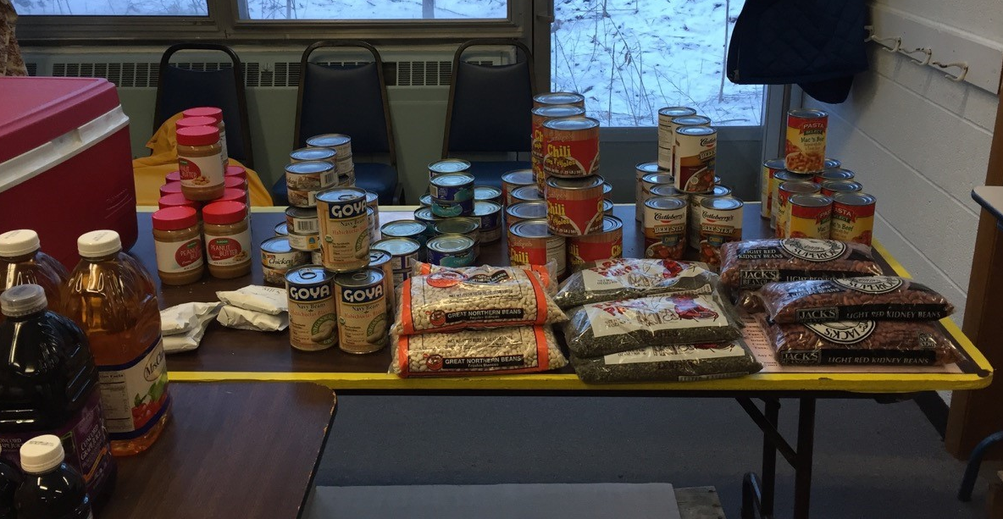
BEFORE
Lentils and dried beans are positioned on front of table easy to reach
Notes:
Because there was an excess of lentils and beans, they all blend in with other protein sources. We wanted to highlight the beans and lentils.

Slide 10
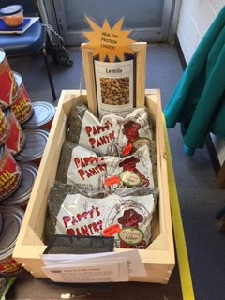
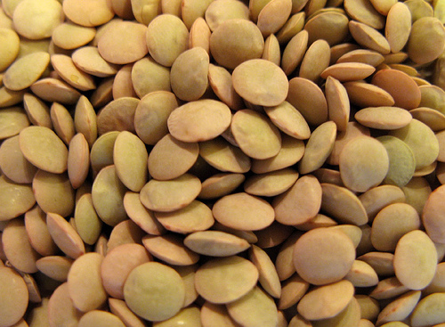
GREAT PROTEIN CHOICE!
AFTER
Lentils
High in Fiber
High in Vitamins and Minerals
Low Fat
Low Sodium
2 pound bag = 20 servings
(1/2 cup is 1 serving)
Rearrange protein display so lentils and beans are featured.
Notes:
Used small, lightweight wooden crates to lay lentils in, created simple sign about health benefits
Star denotes a great protein choice

Slide 11
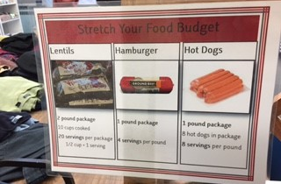
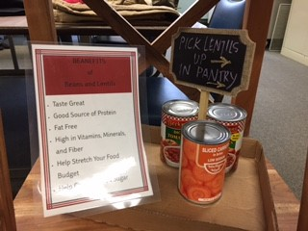
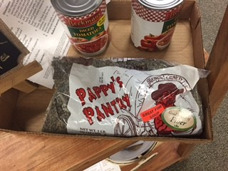
Great signage and point of sale prompts
Notes:
Included lentils in protein list…indicates it is also a source of protein and can go right along with other meats
Great promotional signage and point of sale signage: highlighting lentils in beginning of pantry then follow up sign at proteins table

Slide 12
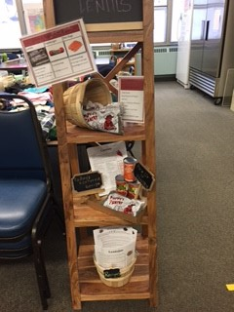
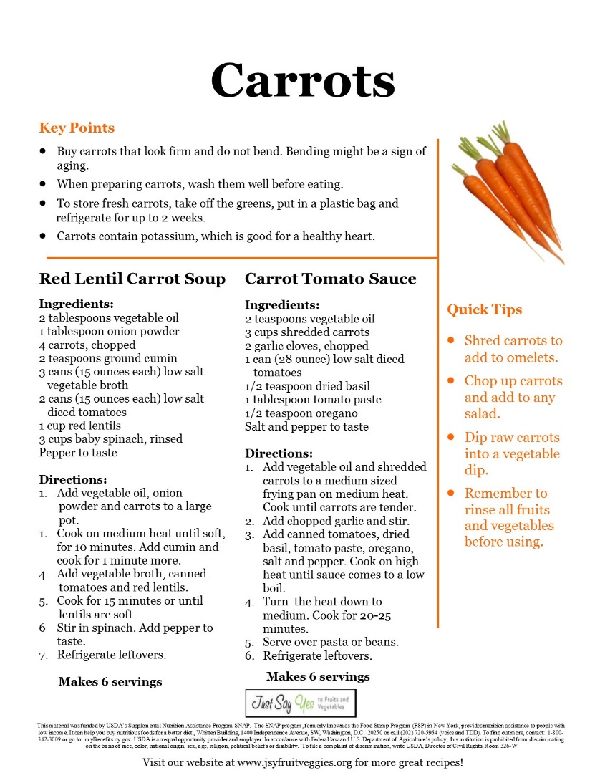
Beautiful Display for Lentils
Display shelf with signage and recipes promoting lentils and kidney beans.
Sample recipe.
Notes:
Use a wooden shelf with baskets and signs to promote further
These are similar to the end caps or speciality areas used in grocery stores
Sample recipe for pantry to offer to guests, often used in food demos by fbcny

Slide 13
P A N T R Y B P R O F I L E
Location: | Canastota, Madison County
Approx. # HH served monthly: | 95
Layout & Signage: | Minimal signage near foods Food stored on shelving Willing to move some items
Inventory & Promotion: | Some posters with other information Fresh produce High inventory of dried beans and whole wheat pasta
Pantry Engagement & Culture: | Has hosted nutrition education Volunteers interact with clients
Foods selected to focus on: | Dried beans & whole wheat pasta

Slide 14
P A N T R Y B S T R A T E G I E S
Layout & Signage: | Display signage for food groups Provided preparation tips & recipes Use chalkboard signs
Inventory & Promotion: | Had highlighted foods in two locations Paired with other items already in pantry—’Meal Kits’
Pantry Engagement & Culture: | Pantry and pantry volunteers assisted with set up Beth provided samples of a delicious recipe using beans and pasta

Slide 15
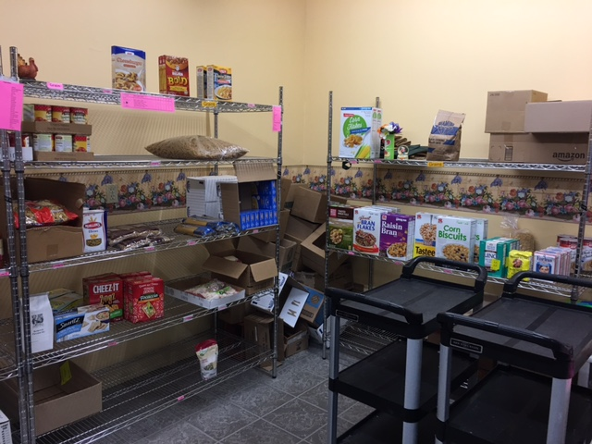
BEFORE
Empty boxes in corner, open areas on shelves
Notes:
Empty boxes stored in corner, shelves looking somewhat bare, items spread out

Slide 16
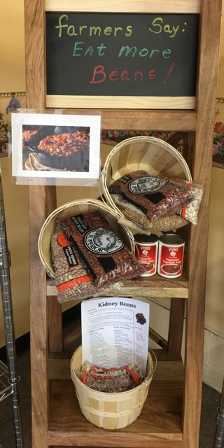
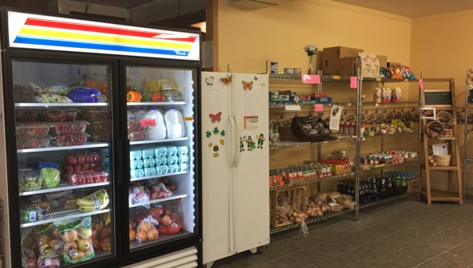
AFTER
Neatly stocked shelves with new display in corner
Wooden display shelf
Notes:
Removed boxes which opened a great corner to made a promotional display. Used a nice wooden shelving units with baskets and a fun chalkboard sign

Slide 17
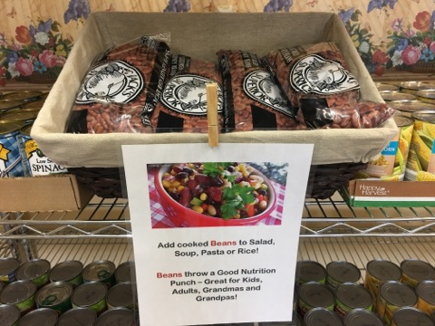
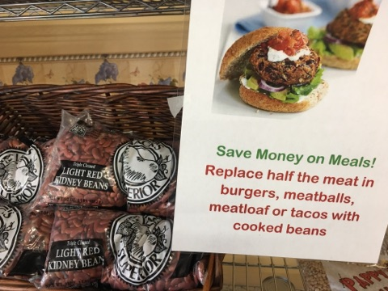
Placed dried beans in two locations
Simple baskets with nutrition tips
Notes:
Simple baskets highlight the beans and make them stand out, similar to a ‘special’ in the supermakert.
Nice color photos of dishes uses beans makes them more appealing

Slide 18
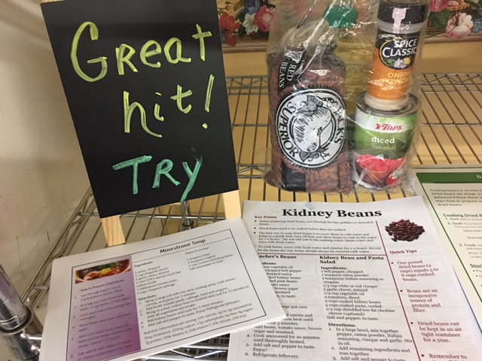
Meal Kit with recipes
Notes:
Created a ‘meal kit’ with additional items in pantry to promote, recipe that included dried bean tips included.

Slide 19
P A N T R Y C P R O F I L E
Location: | Pulaski, Oswego County
Approx. # HH served monthly: | 70
Layout & Signage: | Dried goods in one room, perishables in another Small signs taped onto shelves Willing to move things around
Inventory & Promotion: | Variety of healthy foods Would like to have more fresh produce
Pantry Engagement & Culture: | Volunteers interact with clients Would like to promote healthy foods
Foods selected to focus on: | Dried beans and fresh produce

Slide 20
P A N T R Y C S T R A T E G I E S
Layout & Signage: | Removed old furniture, moved fridge next to each other Created room for a shelf for fresh produce Food group banners, magnetic clips, and clip on chalkboards replaced taped on signs
Inventory & Promotion: | Highlighted healthy foods with white trays and bins ‘Fill a bag’ for fresh produce shelf Ordered more fresh produce Used retail promotional stickers on healthy foods—”Low Salt” “Great Source of Fiber” “Great for Soups” and “Healthy Choice”
Pantry Engagement & Culture: | Encouraged clients to take more produce Volunteers and guests noted changes Pantry also painted rooms, new lighting

Slide 21
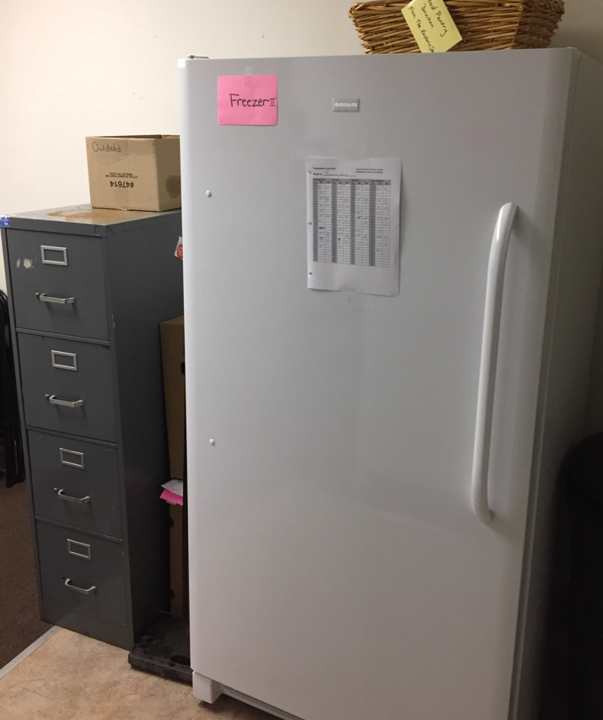
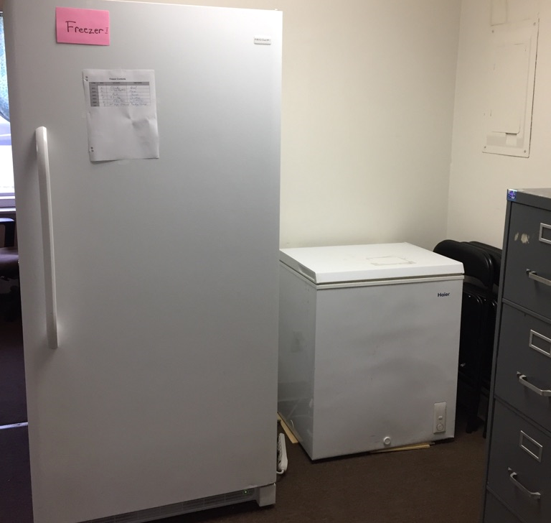
BEFORE
Unused filing cabinet
Tight corner
Notes:
Filing cabinet just taking up space, wasn’t being used. One freezer (mainly used for back up items) was in a tight corner so not easily accessible.

Slide 22
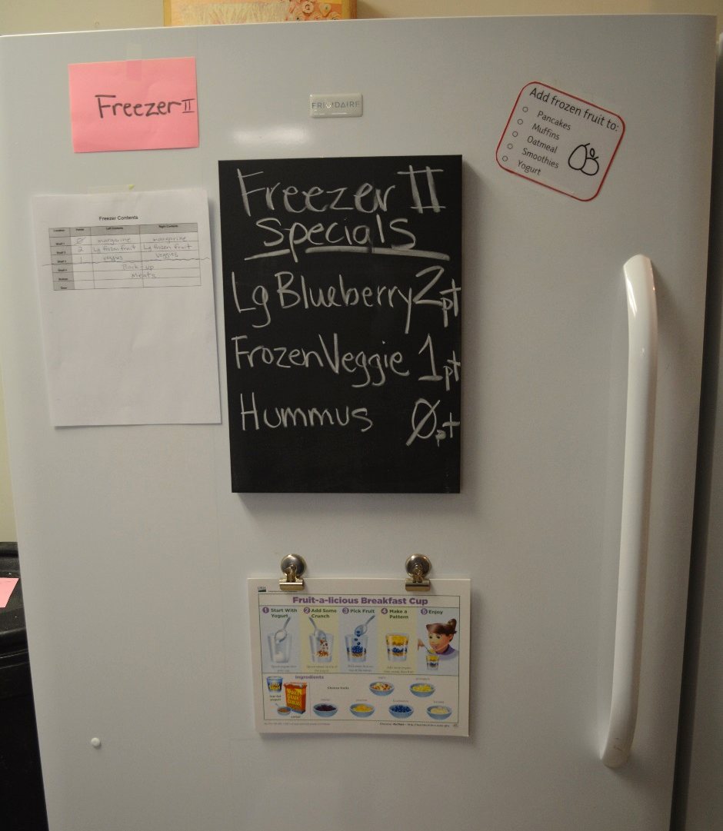
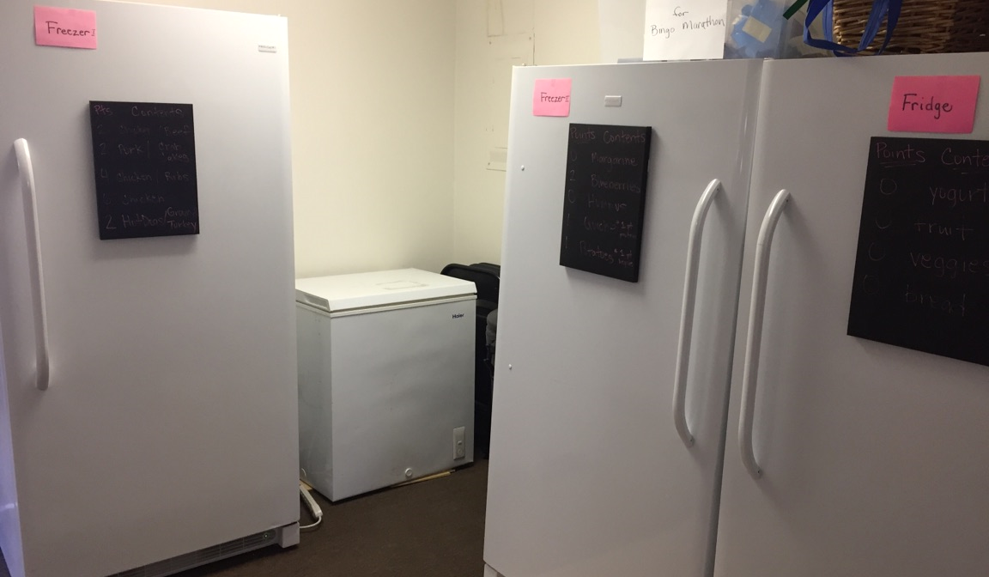
AFTER
Appliances grouped together, added chalkboard signs
Notes:
Simply removed filing cabinet and moved all appliances together. Chalkboard signs now used to promote specific foods, magnetic clips for recipes or tips

Slide 23
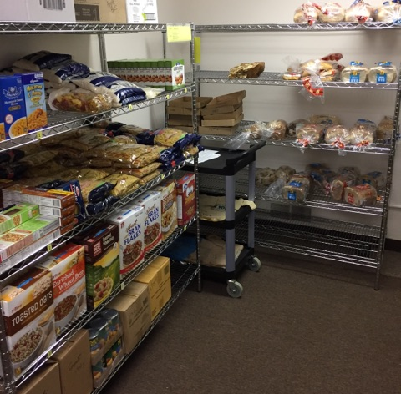
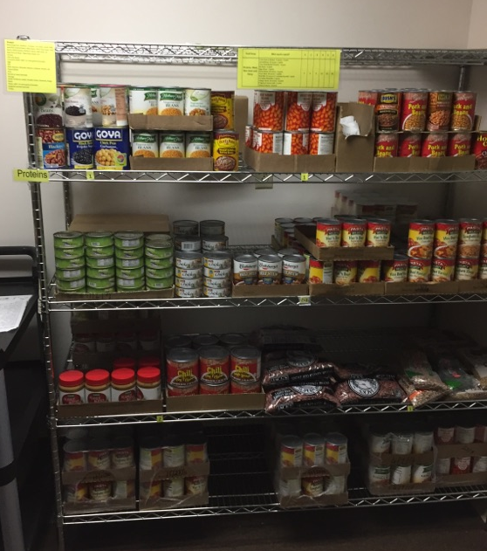
BEFORE
Taped on signs and no promotional items
Notes:
Taped signs constantly fell off, looked kind of messy

Slide 24
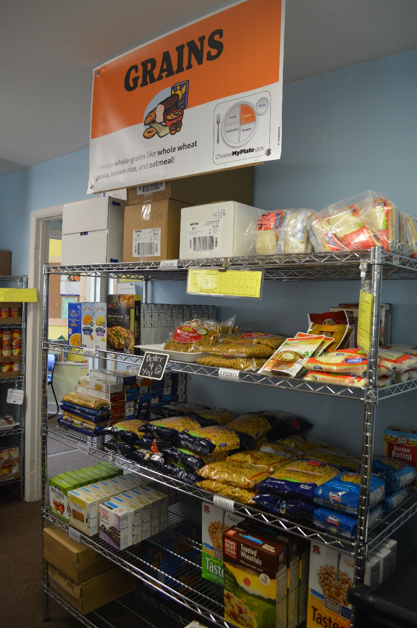
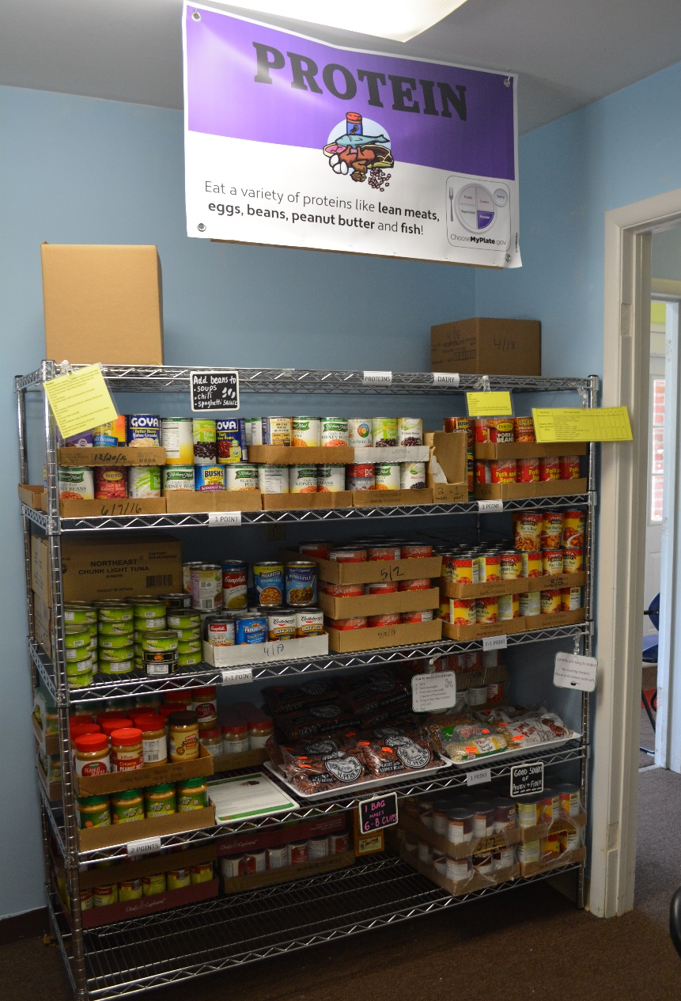
AFTER
Notes:
Created food group banners and are placed above corresponding food groups, includes a simple nutrition message and color with graphic

Slide 25
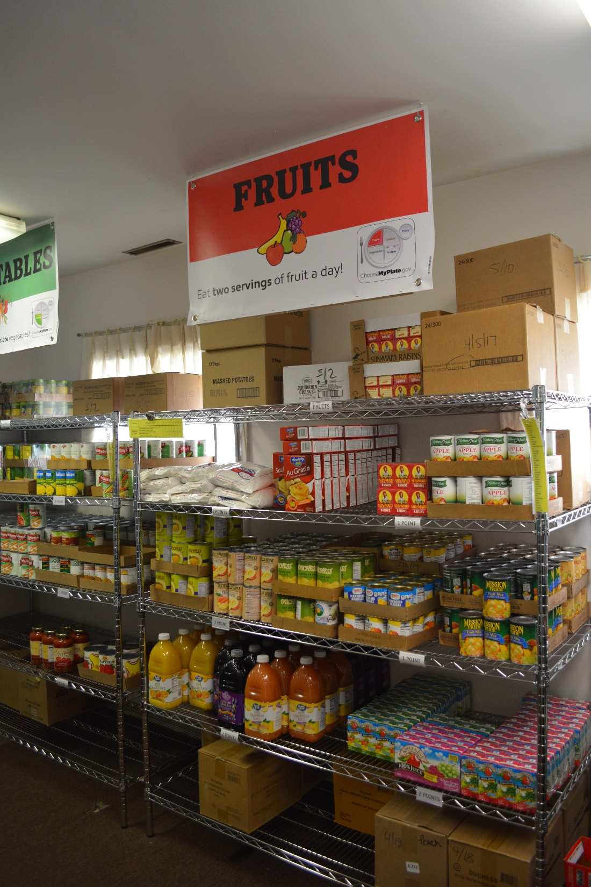
AFTER
Notes:
Veg and fruit one

Slide 26
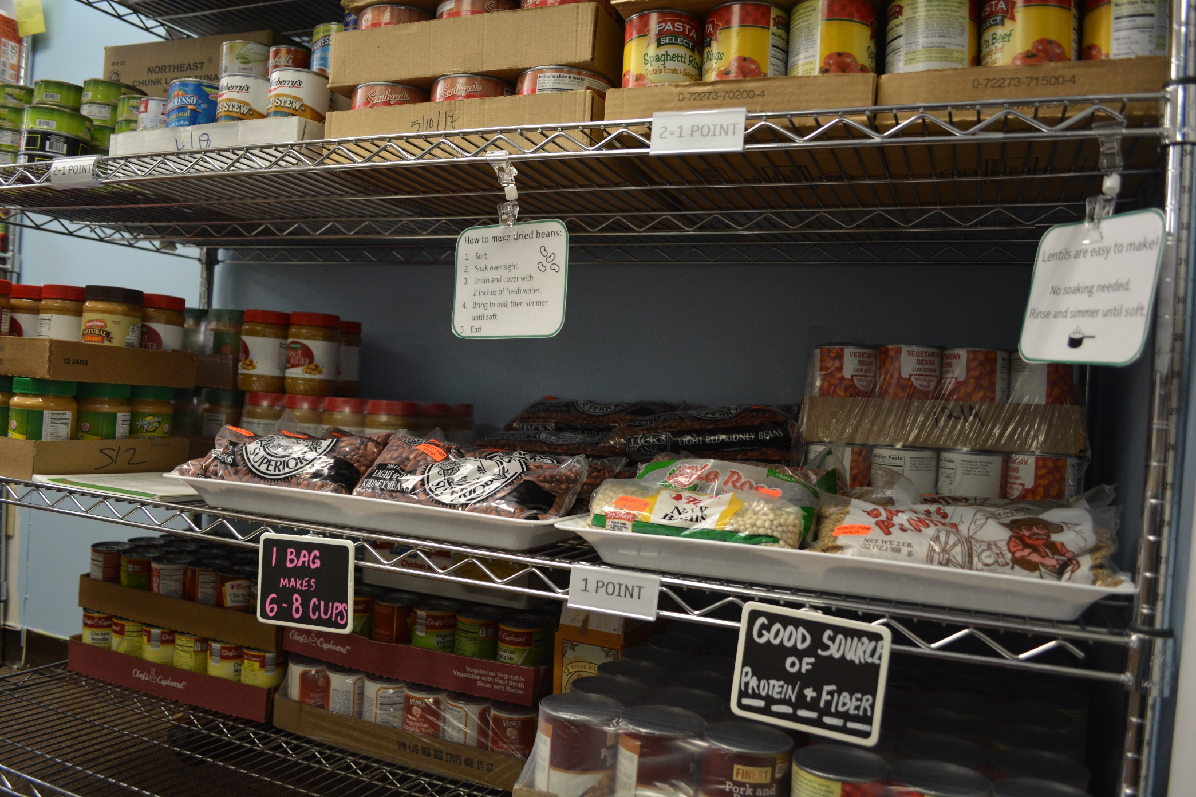
Clip on sign holders and reusable chalkboard signs
Notes:
Clip on signs are adjustable, clip on chalkboard, can be used over and over
Can see the clear snap in signs for points---these fit perfectly on metal shelving that is in pretty much every food pantry

Slide 27
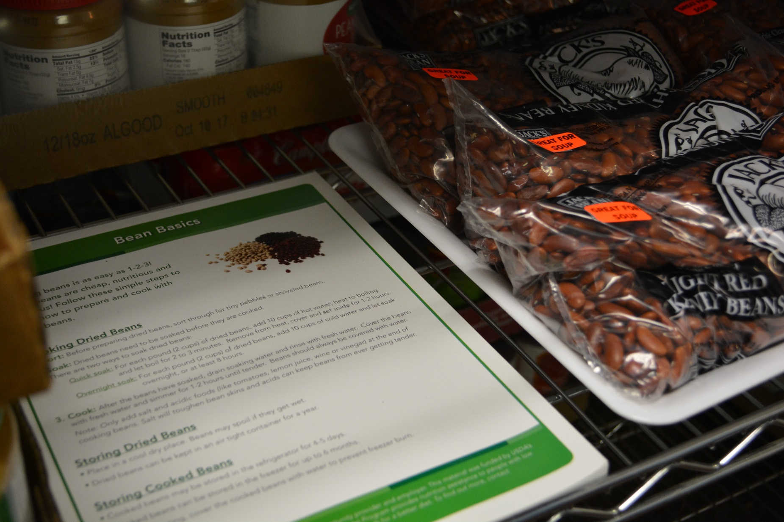
Handouts next to dried bean display
Notes:
Have bean prep tips right next to dried beans, can see one of the promo stickers

Slide 28
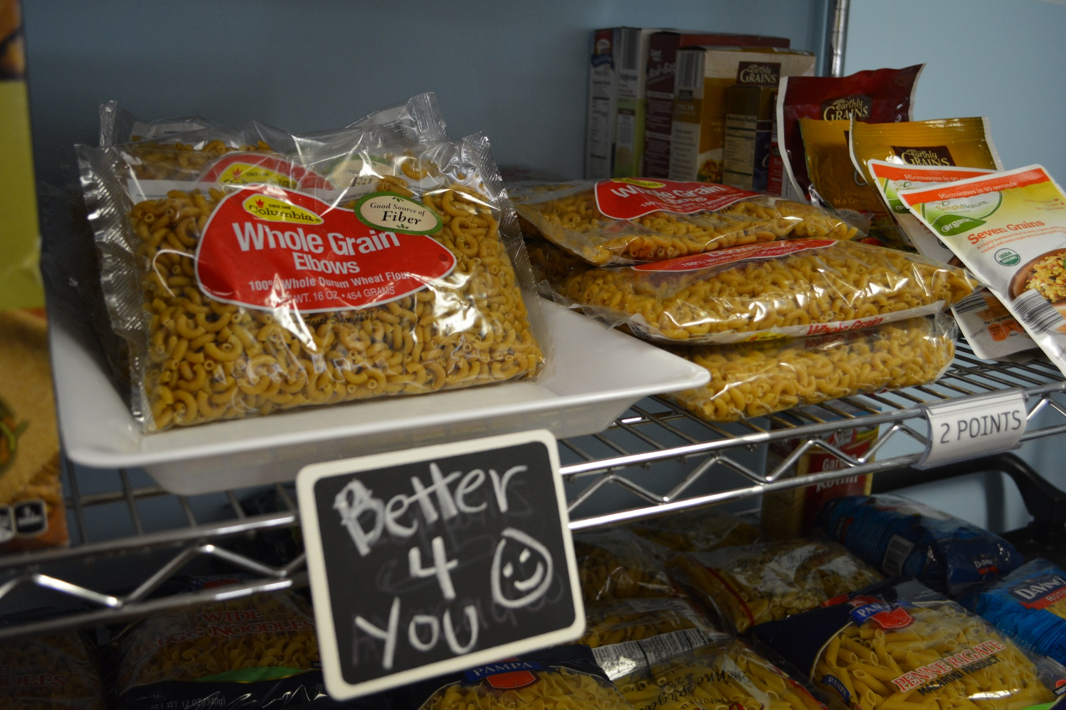
Tray and small sign to highlight whole wheat pasta
Notes:
Used a simple white tray from a party store to place bags on

Slide 29
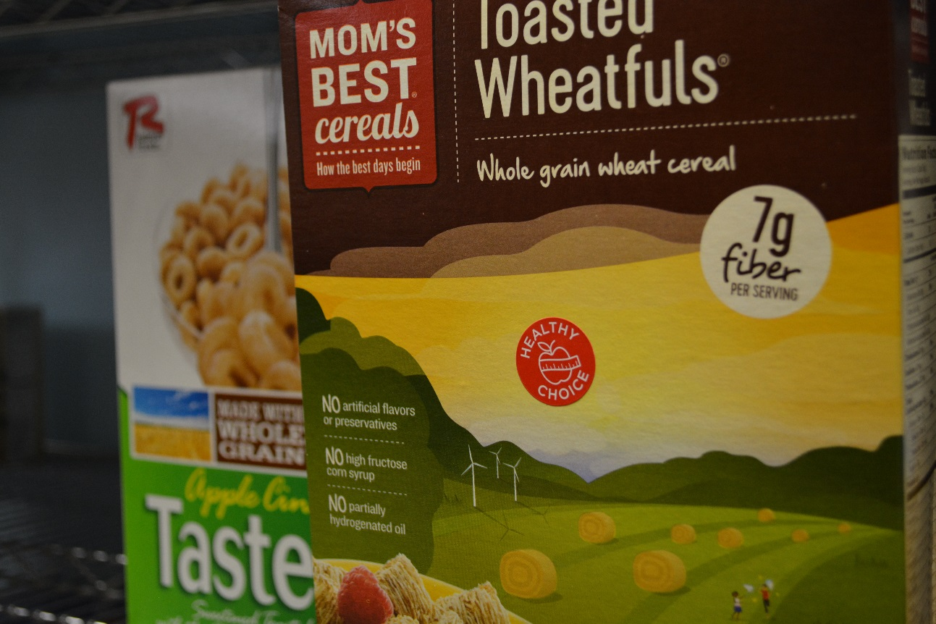
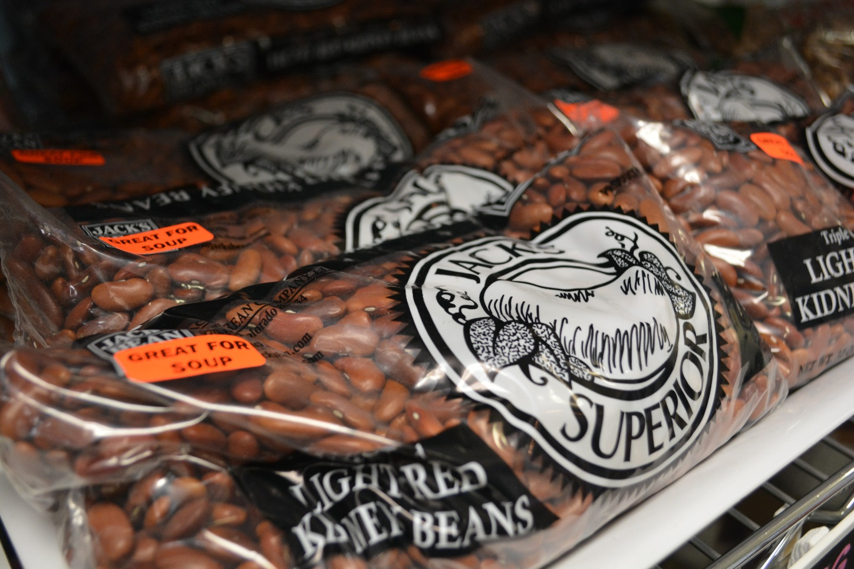
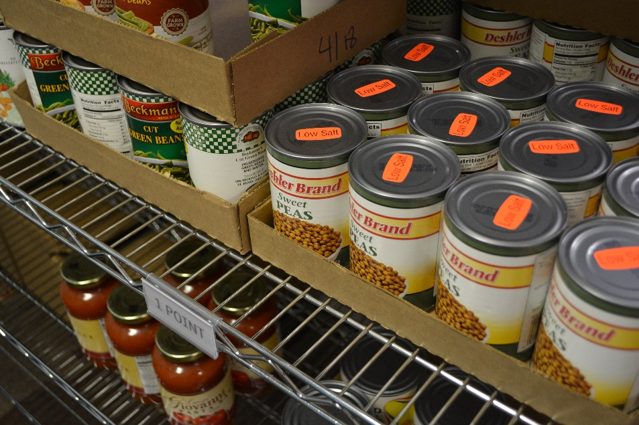
Notes:
Promo stickers

Slide 30
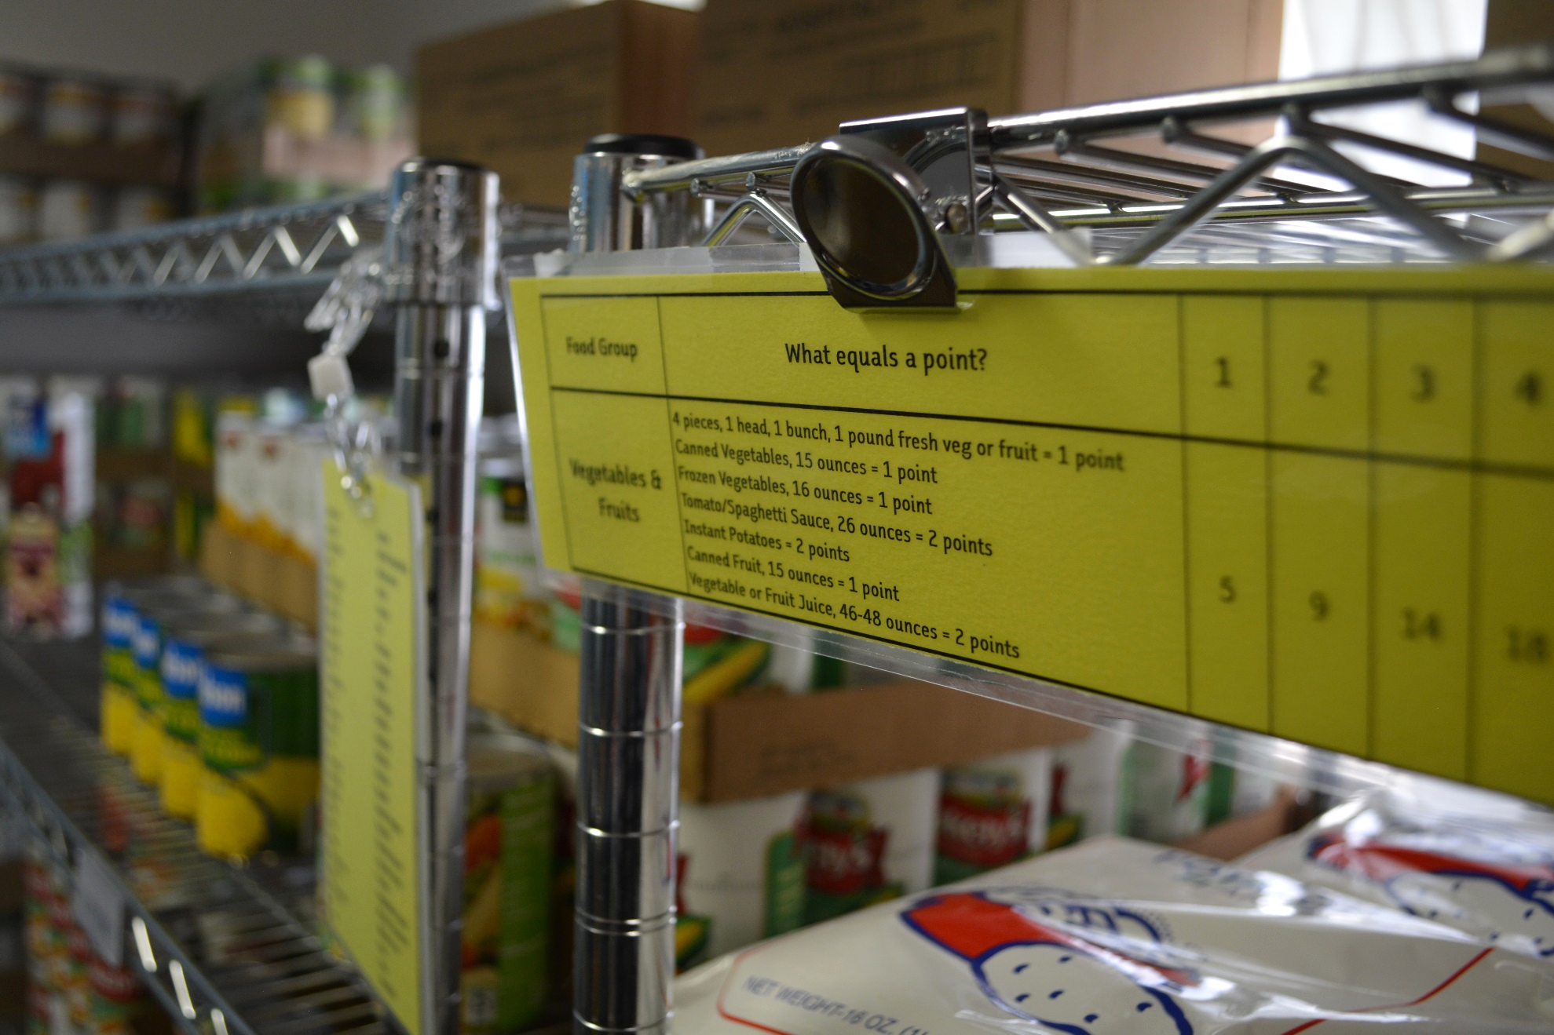
Magnetic clip replaced taped on signs
Notes:
Clip on magnets

Slide 31
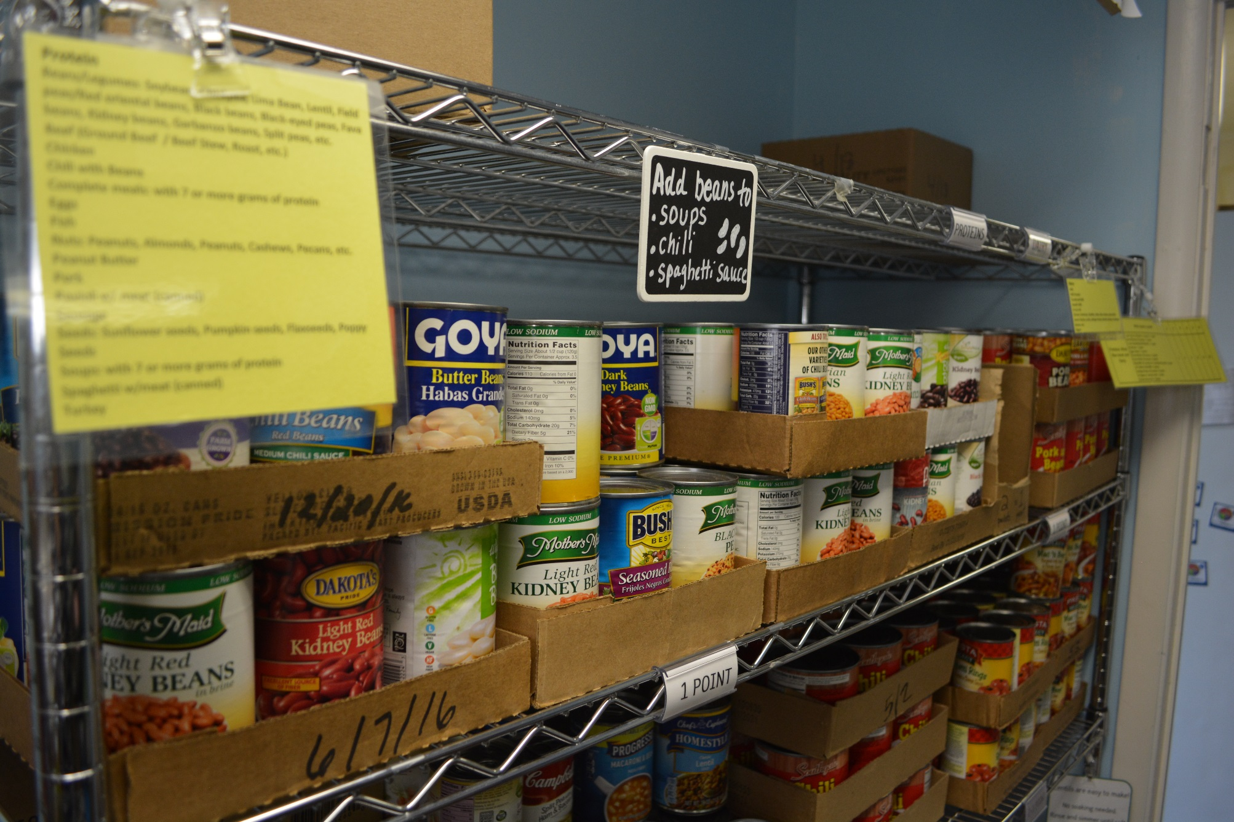
Small sign gives tips on eating more beans

Slide 32
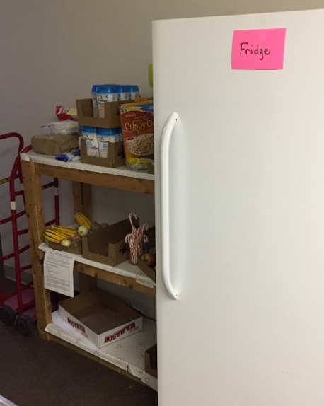
BEFORE
Made wooden shelf just for produce
Notes:
Be the produce area

Slide 33
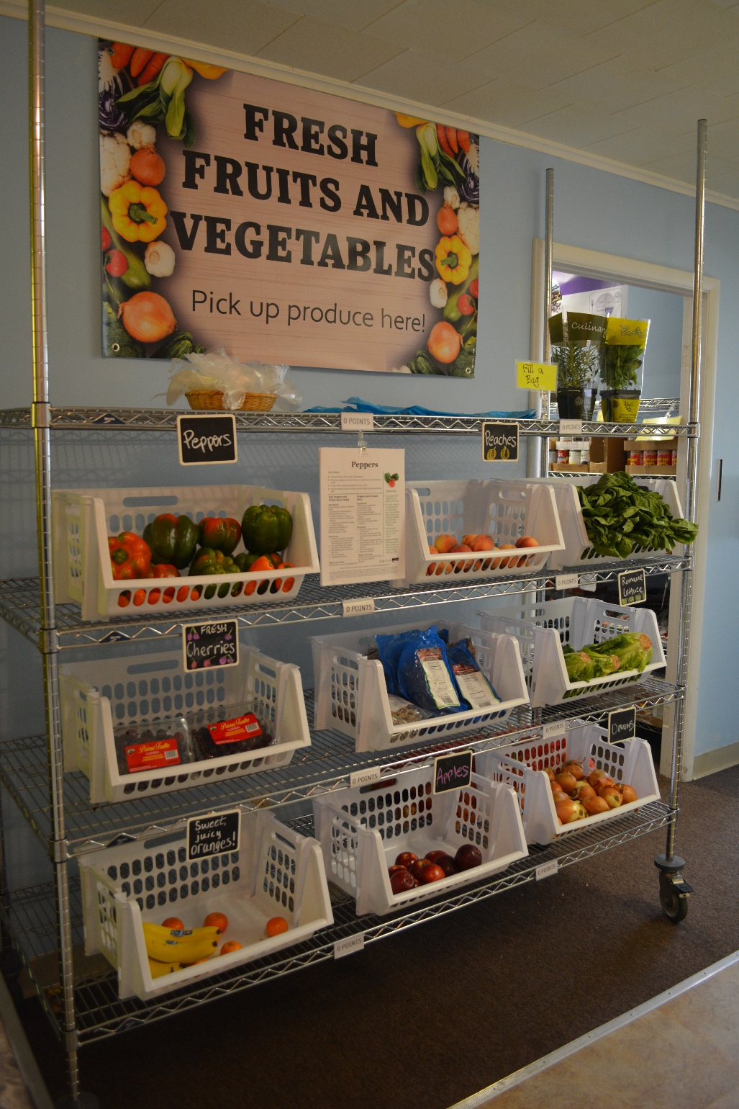
AFTER
Dedicated a display for just fresh fruits and vegetables
Notes:
Created a banner, metal shelving dedicated for produce, affordably prices white bins, fill a bag

Slide 34
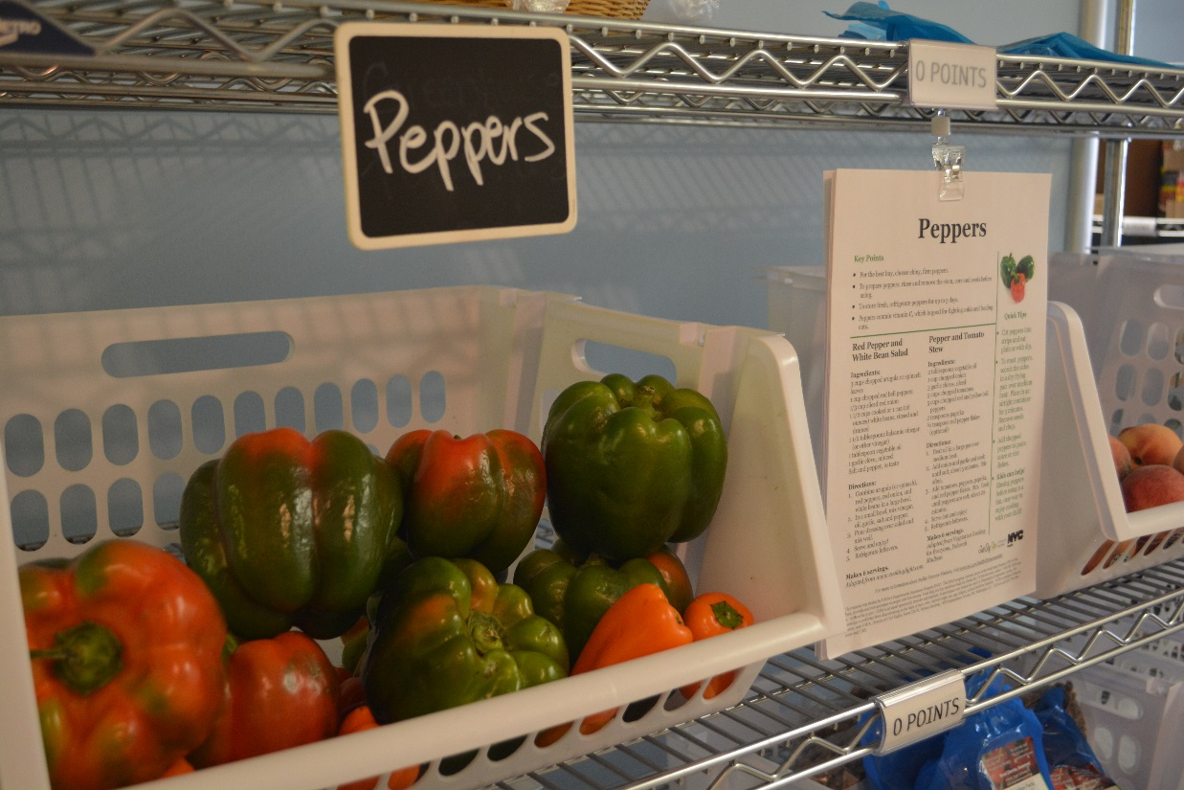
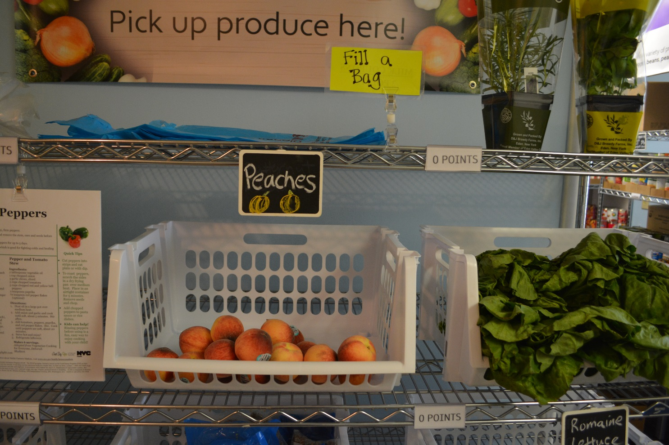
‘Fill a Bag’ for all guests
Recipes for produce

Slide 35
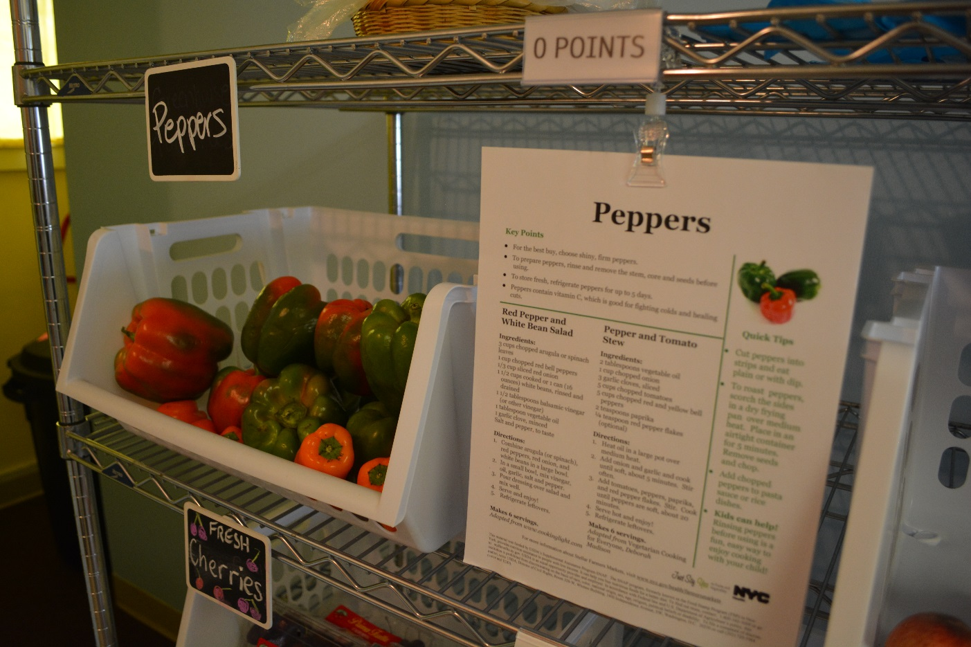
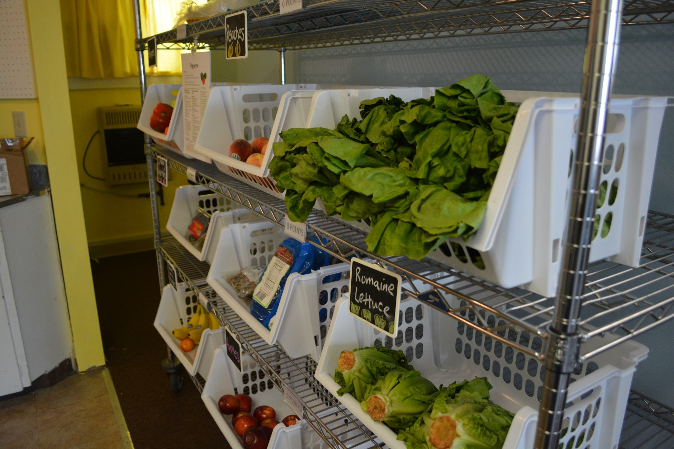

Slide 36
Now it’s your turn!
Fill out a Healthy Pantry Assessment
Share where your site will start

