Slide 1
The Wasted Food Issue Global Impacts, Local Solutions

Slide 2
Jesse Kerns M.P.S. Environmental Science (Coupled Natural & Human Systems) SUNY College of Environmental Science & Forestry

Slide 3
Program Coordinator Syracuse University
Center for Sustainable Community Solutions

Slide 5
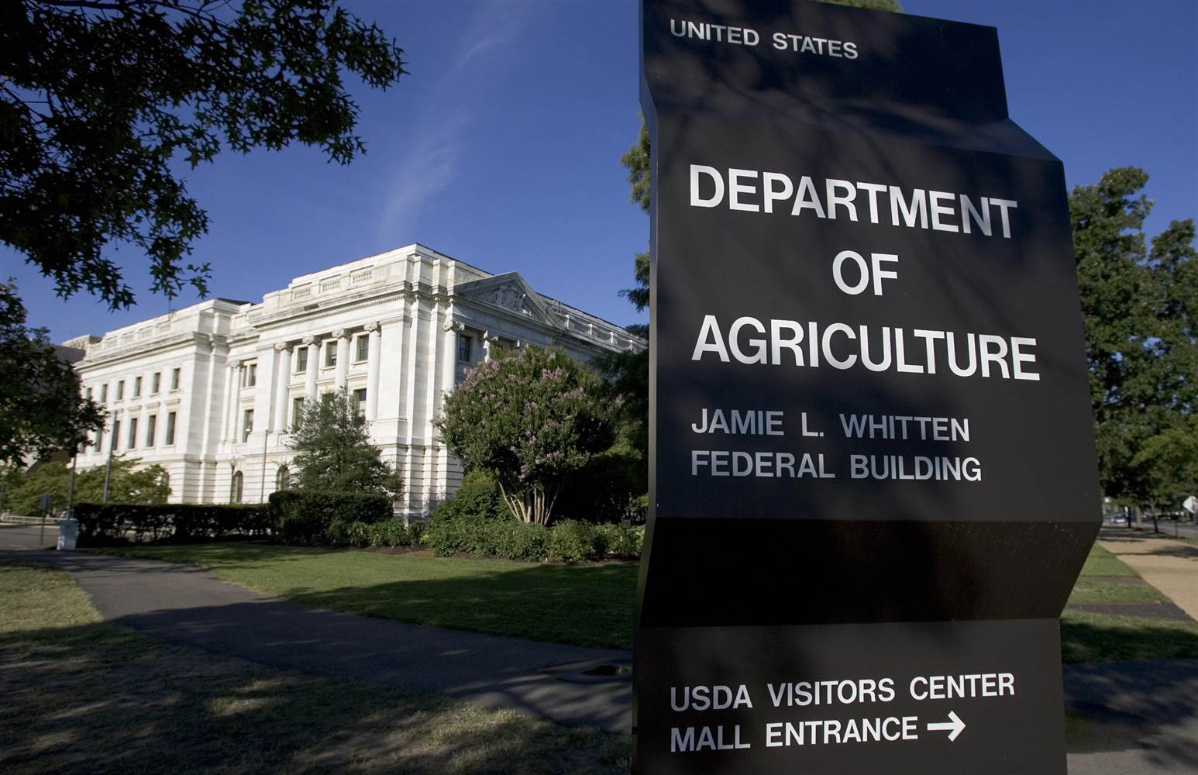

Slide 6
Sustainable Materials Management

Slide 7
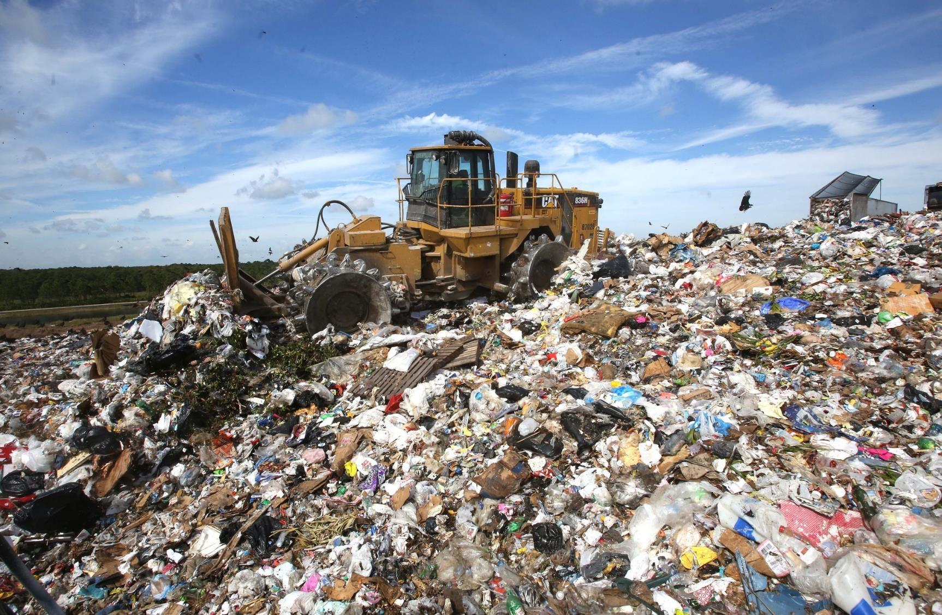
Notes:
The old, linear model.

Slide 9
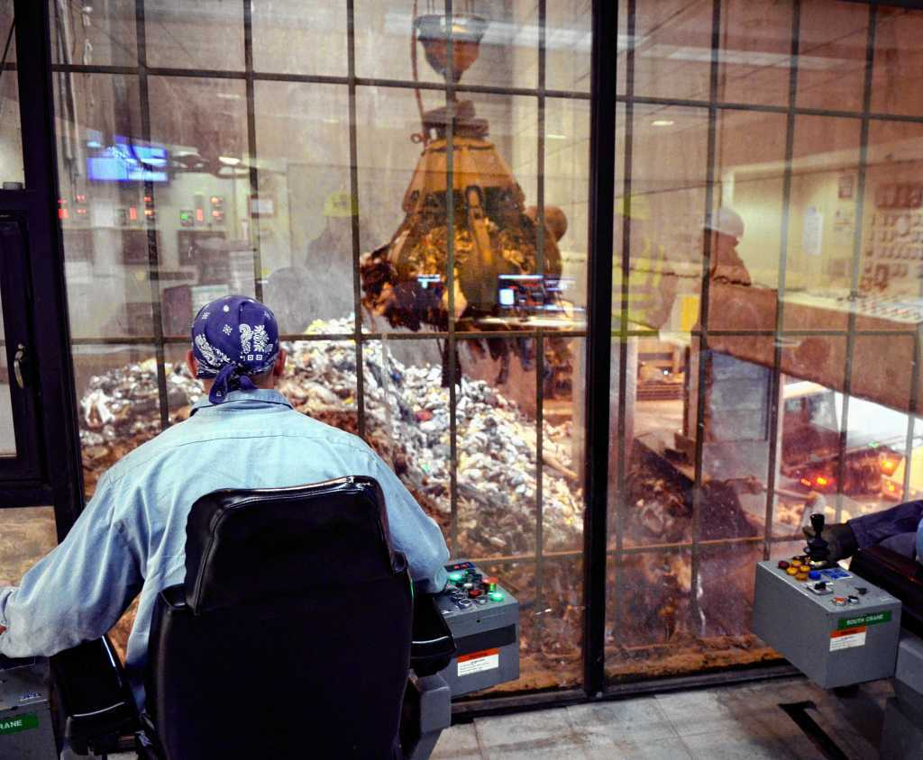

Slide 10
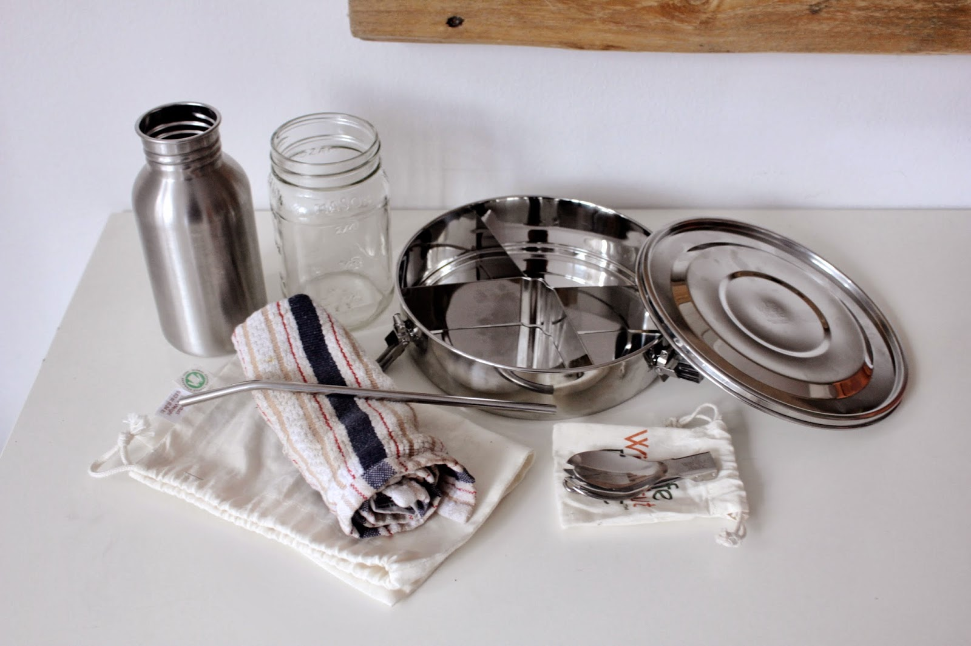
Reduce single-use items.
Notes:
Reduce (i.e., pollution prevention)

Slide 11
Reuse materials for new purposes.
Notes:
Reduce

Slide 12
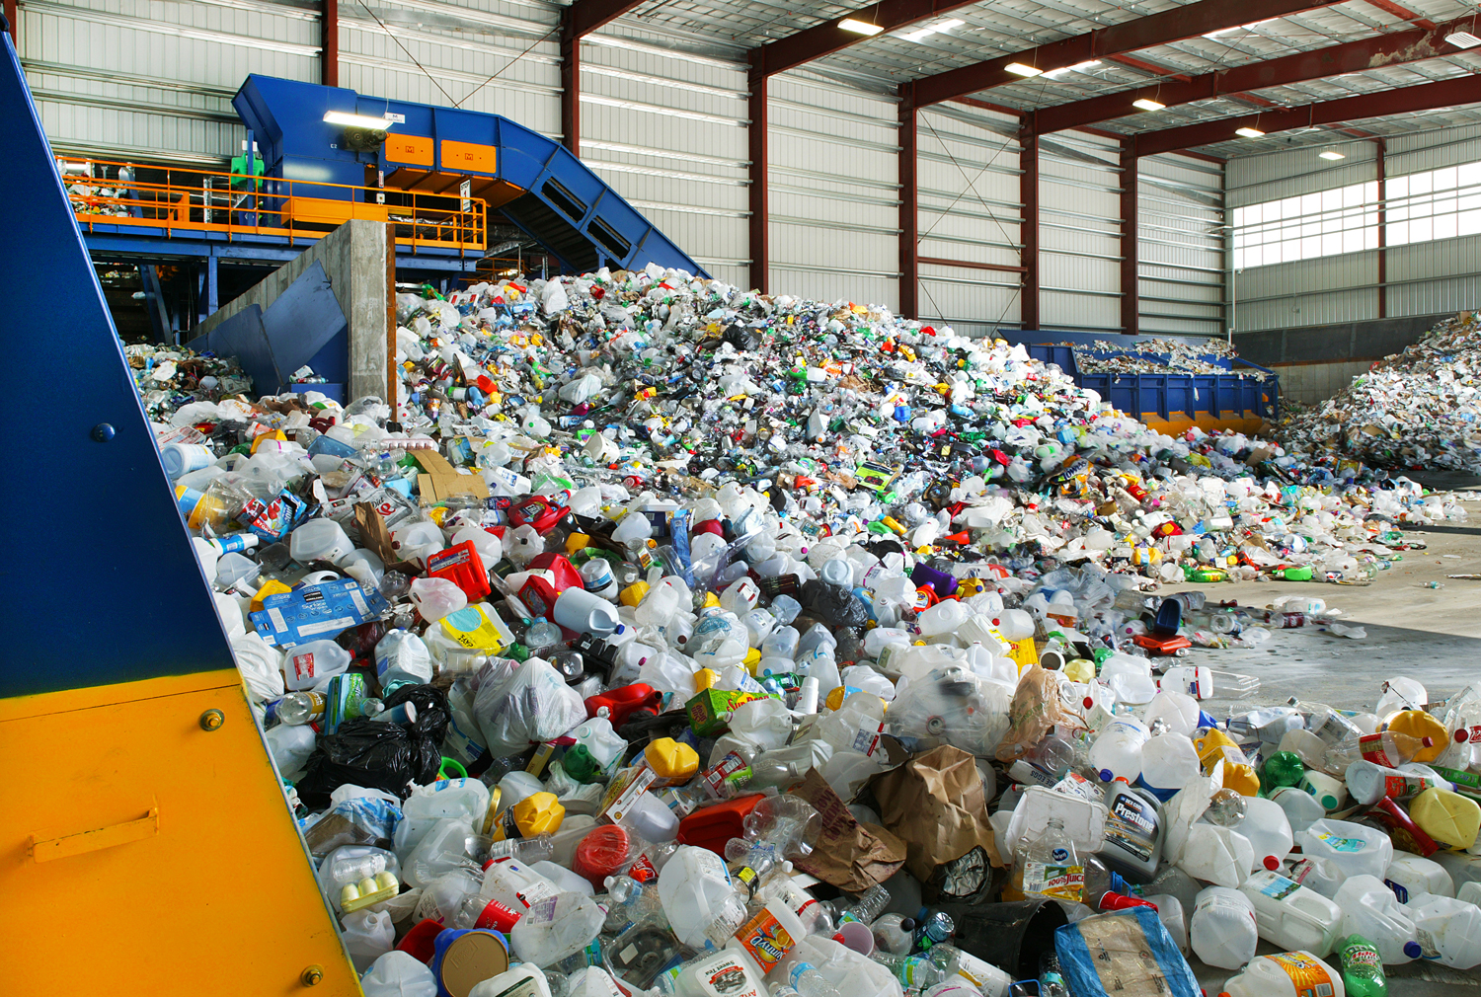
Recycle items into new goods.
Notes:
Recycle

Slide 13
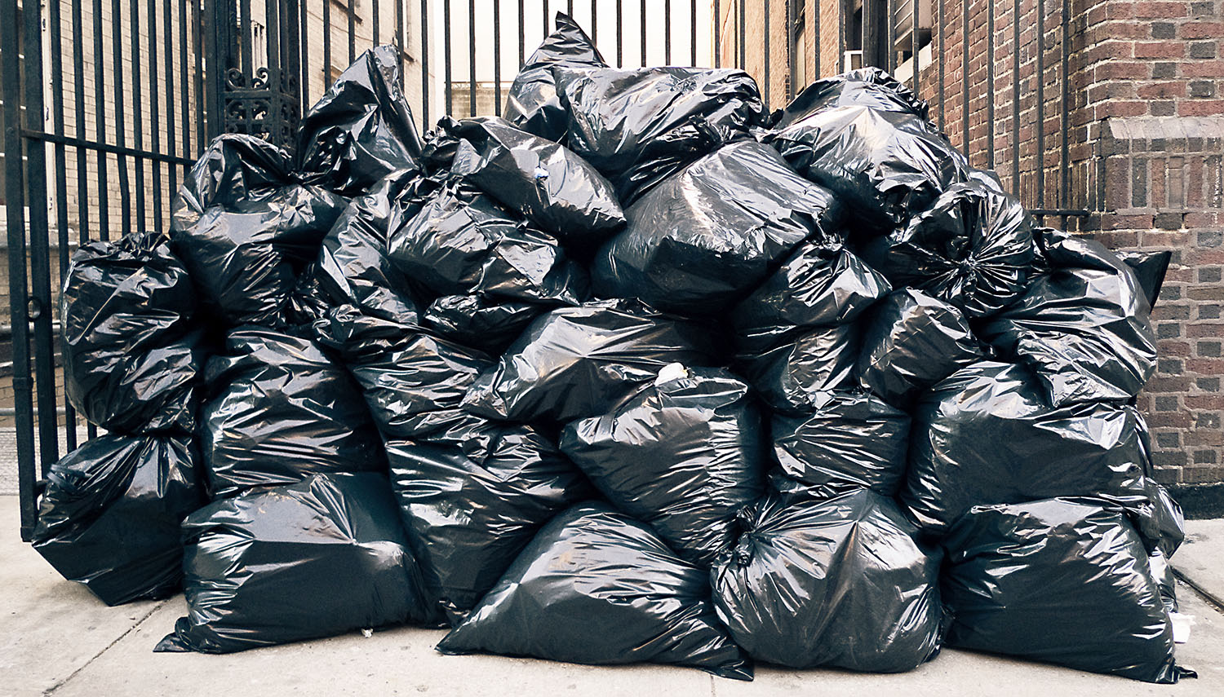
Garbage, Trash, Waste, Rubbish, Refuse, Junk
Garbage, Trash, Waste, Rubbish, Refuse, Junk

Slide 14
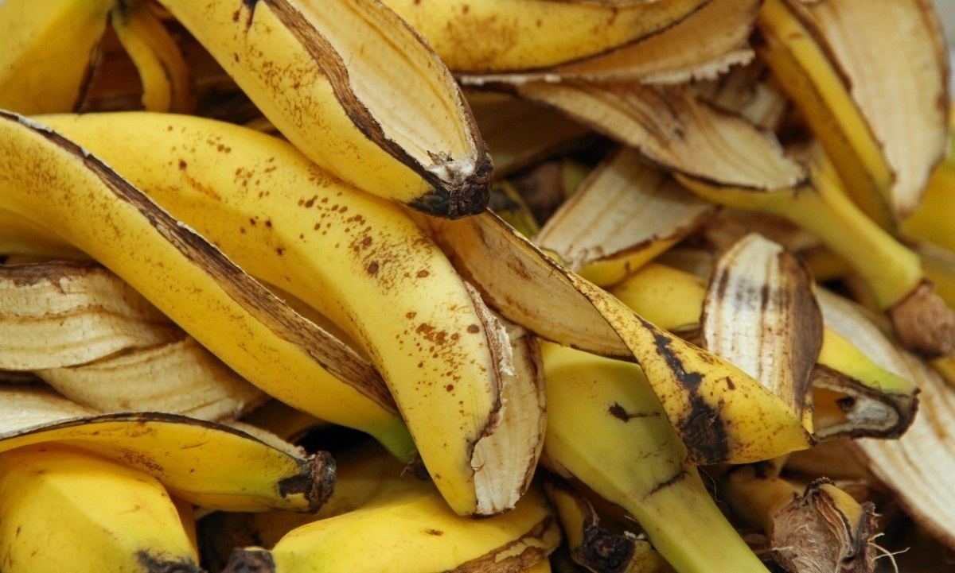

Slide 16
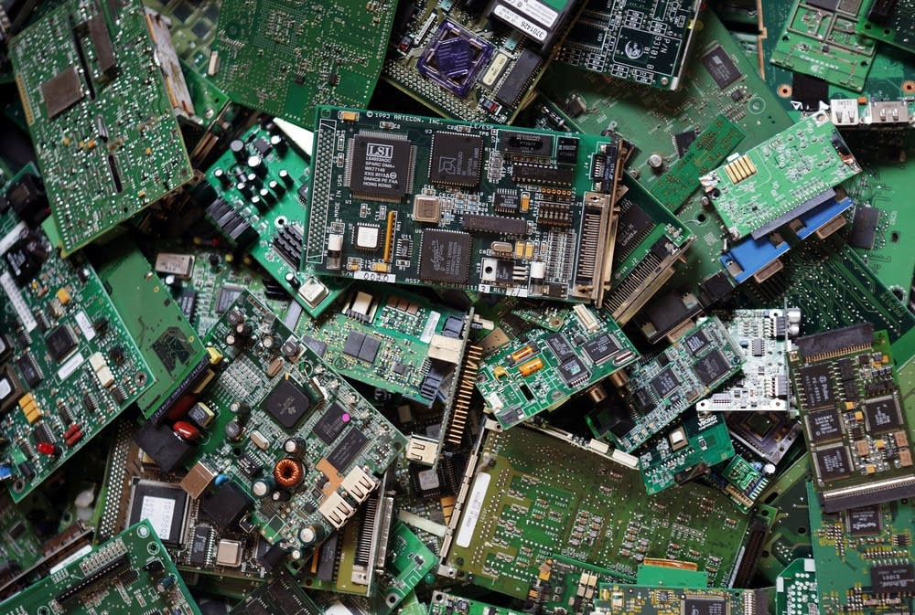

Slide 17
Protect public health while fulfilling material needs.

Slide 18
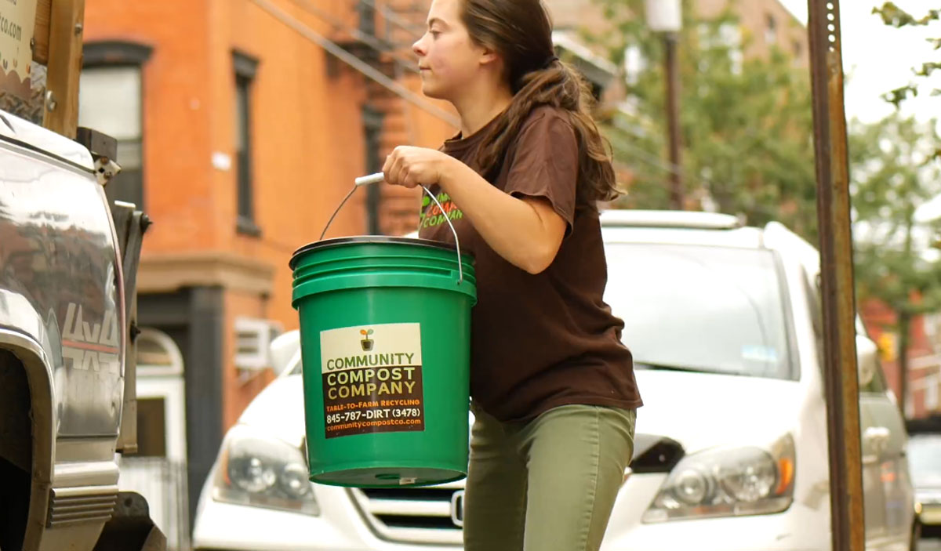
Create new jobs and salable goods from materials previously regarded as “waste”.

Slide 19
Preserve natural resources and ecosystem services.

Slide 20
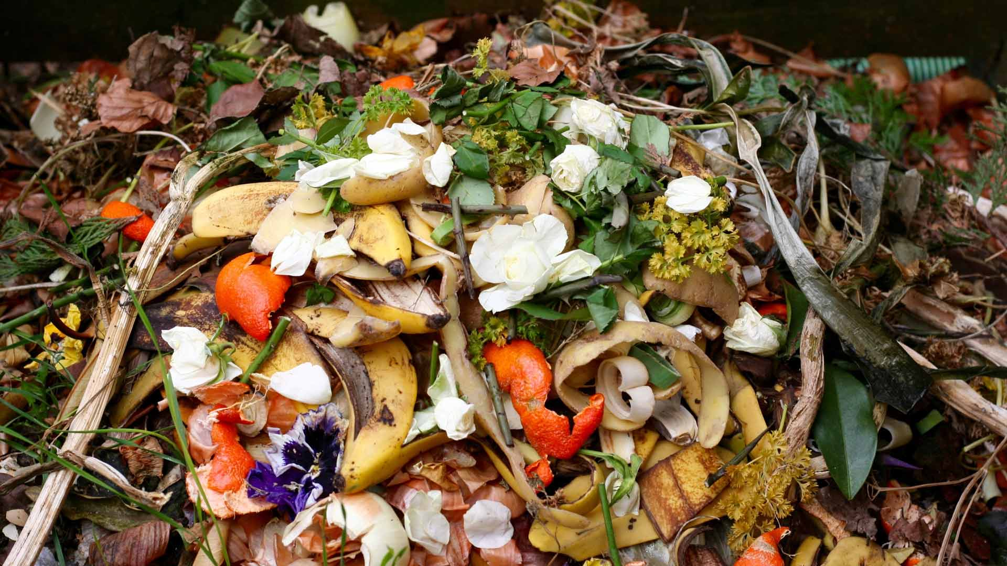
Organic Materials

Slide 21
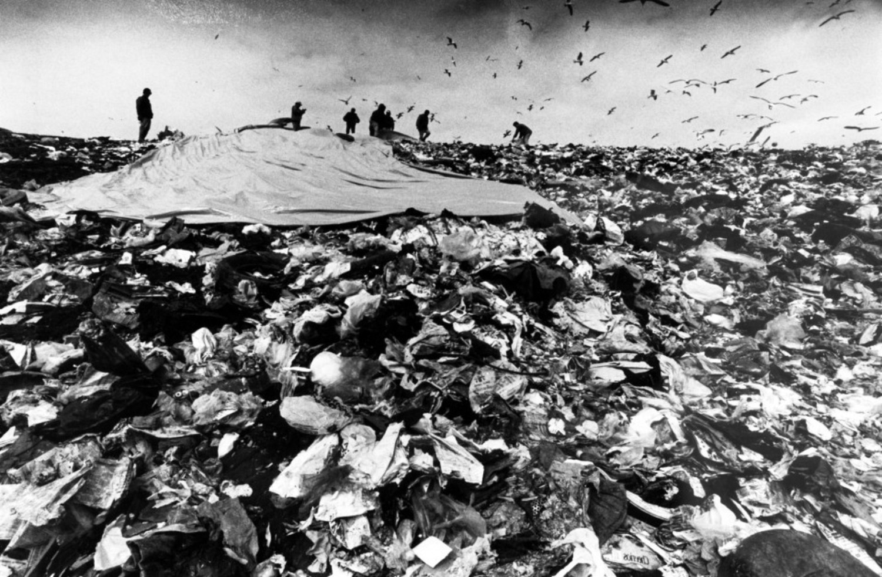
Organic materials make up 1/3* of the municipal solid waste stream. (Source: Environmental Protection Agency, 2016)

Slide 22
~50% of disposed organics are “yard trimmings”. (Source: Environmental Protection Agency, 2016)

Slide 23
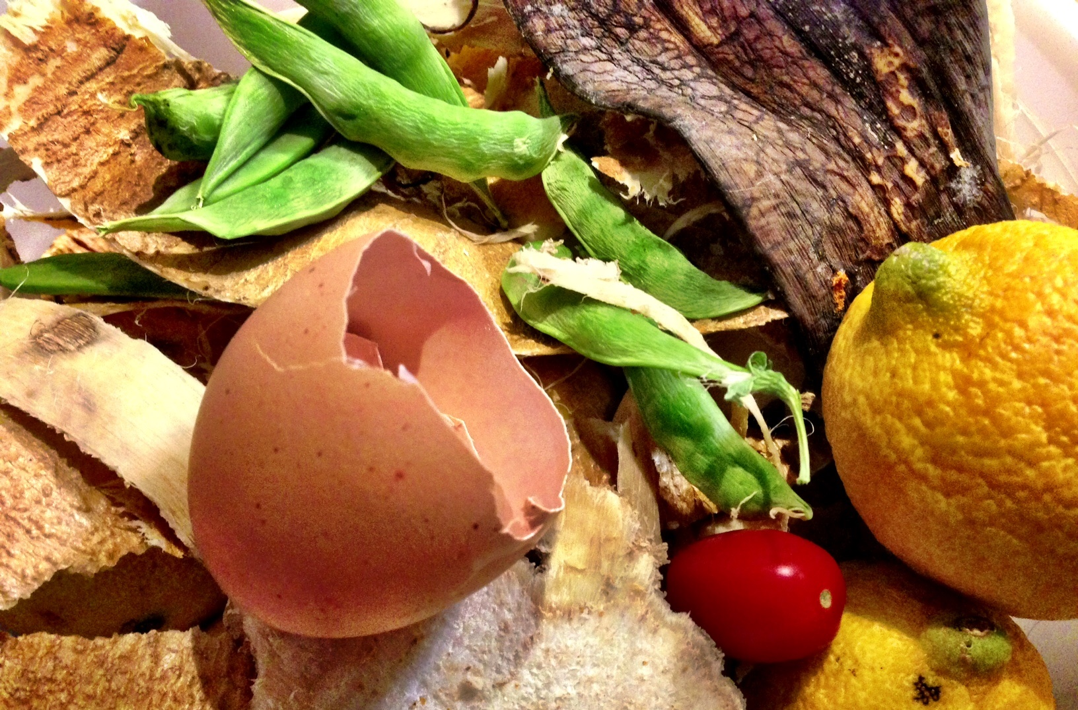
~50% of disposed organics is “food”. (Source: Environmental Protection Agency, 2016)

Slide 24
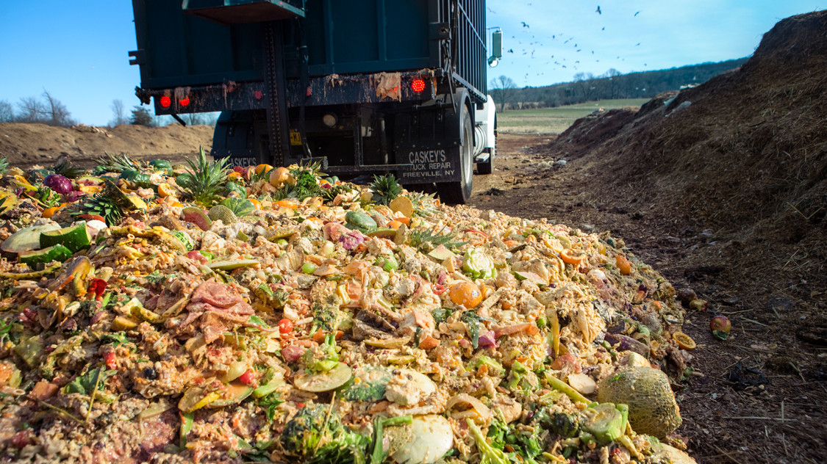
30-40% of food produced in the U.S. does not get eaten. (Source: United States Department of Agriculture, 2017)

Slide 25
Residences account for approximately 43% of wasted food generated. (Source: Rethink Food Waste Through Economics and Data, 2016)

Slide 26
“Uneaten food has an annual estimated cost of $218 billion, costing a household of four an average of $1,800 annually.” (Source: National Resources Defense Council, 2017)

Slide 27
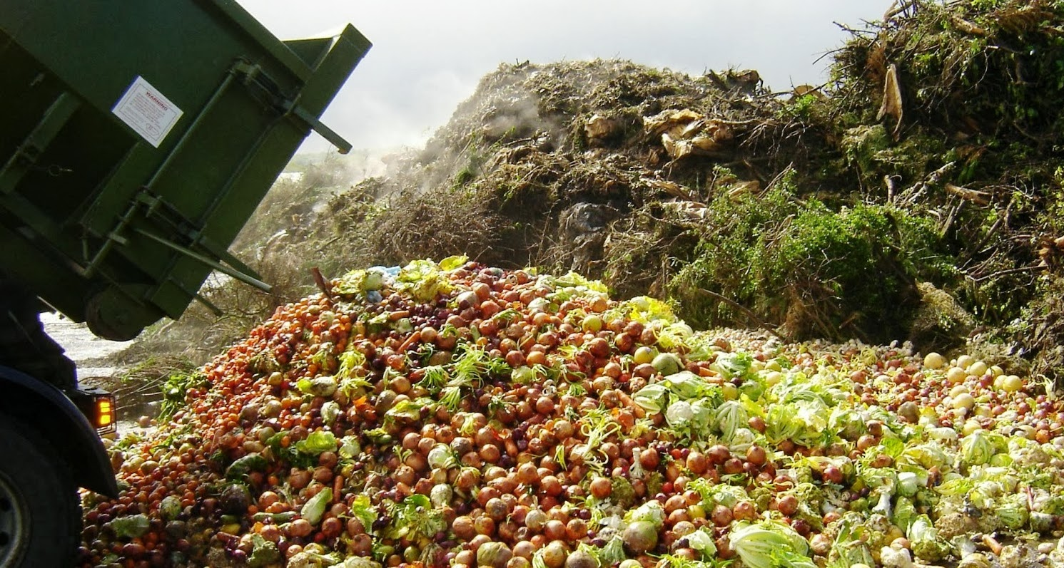
If global food waste were a country, it would rank 3rd in greenhouse gas emissions. (Source: Food and Agriculture Organization of the United Nations)

Slide 28
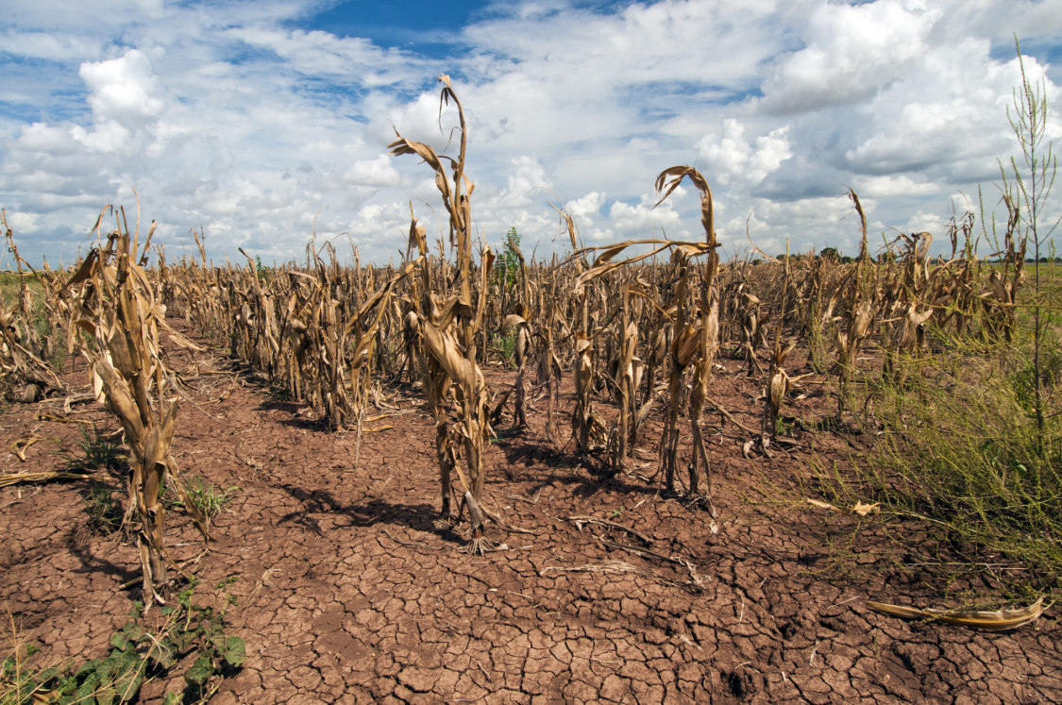
Reducing wasted food is the third most impactful climate change mitigation action. (Source: Project Drawdown, 2017)

Slide 29
In NYS, 1 in 8 people are estimated to be facing food insecurity. (Source: United States Department of Agriculture, 2017)

Slide 30
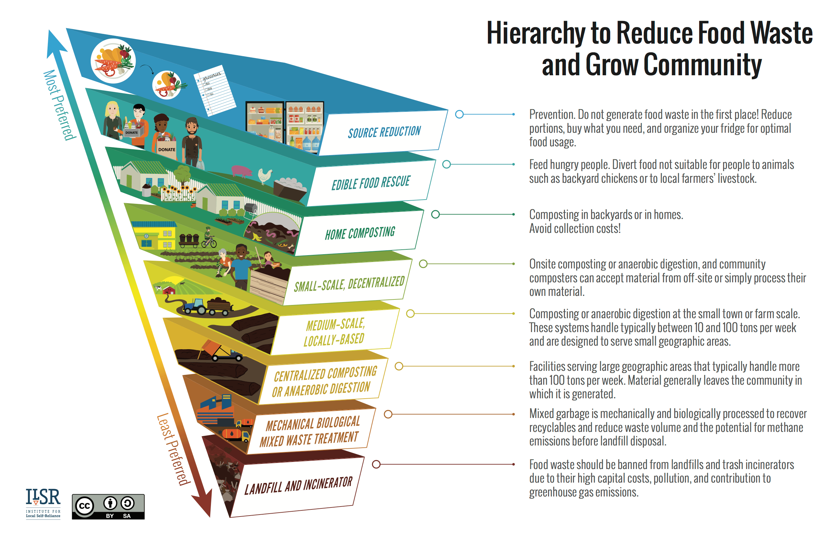

Slide 31
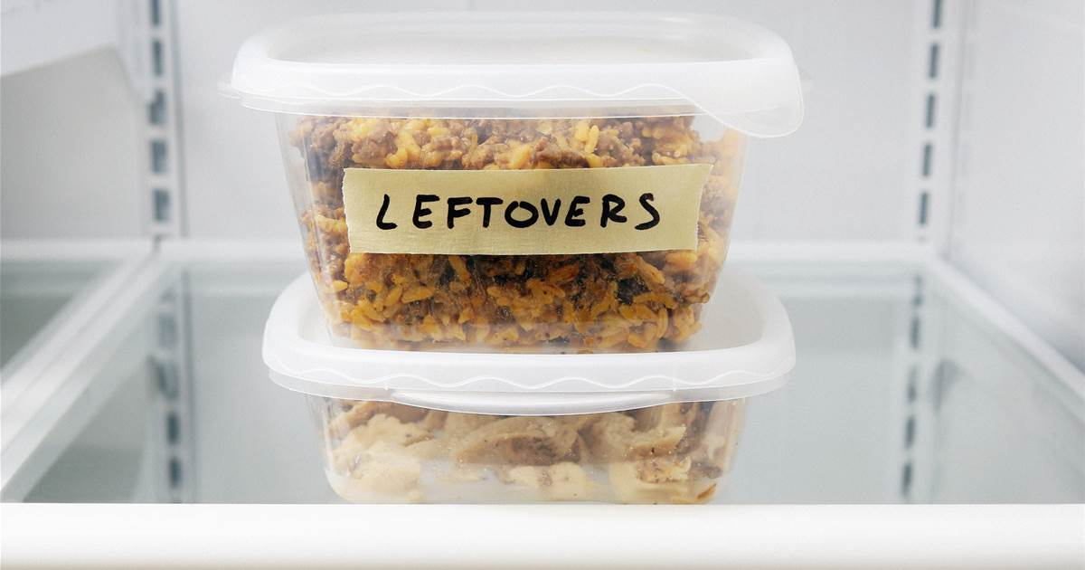
Commit to eating all leftover and perishable foods first.

Slide 32
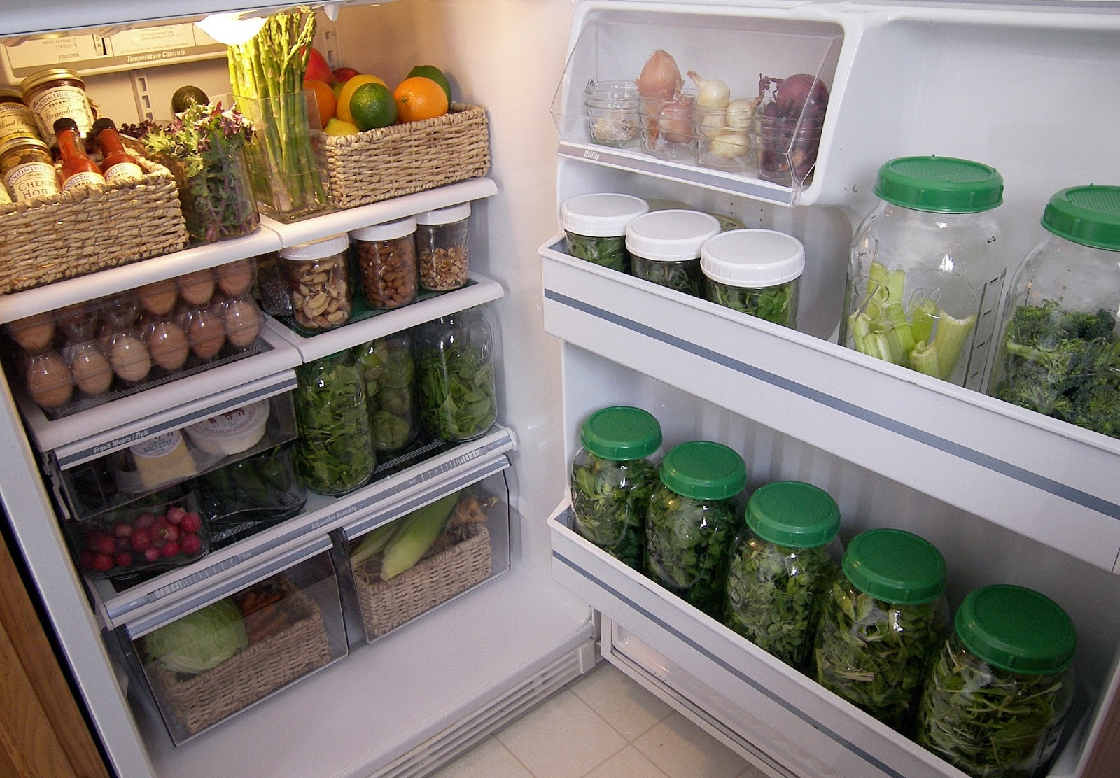
Check your refrigerator and pantry before shopping.

Slide 33
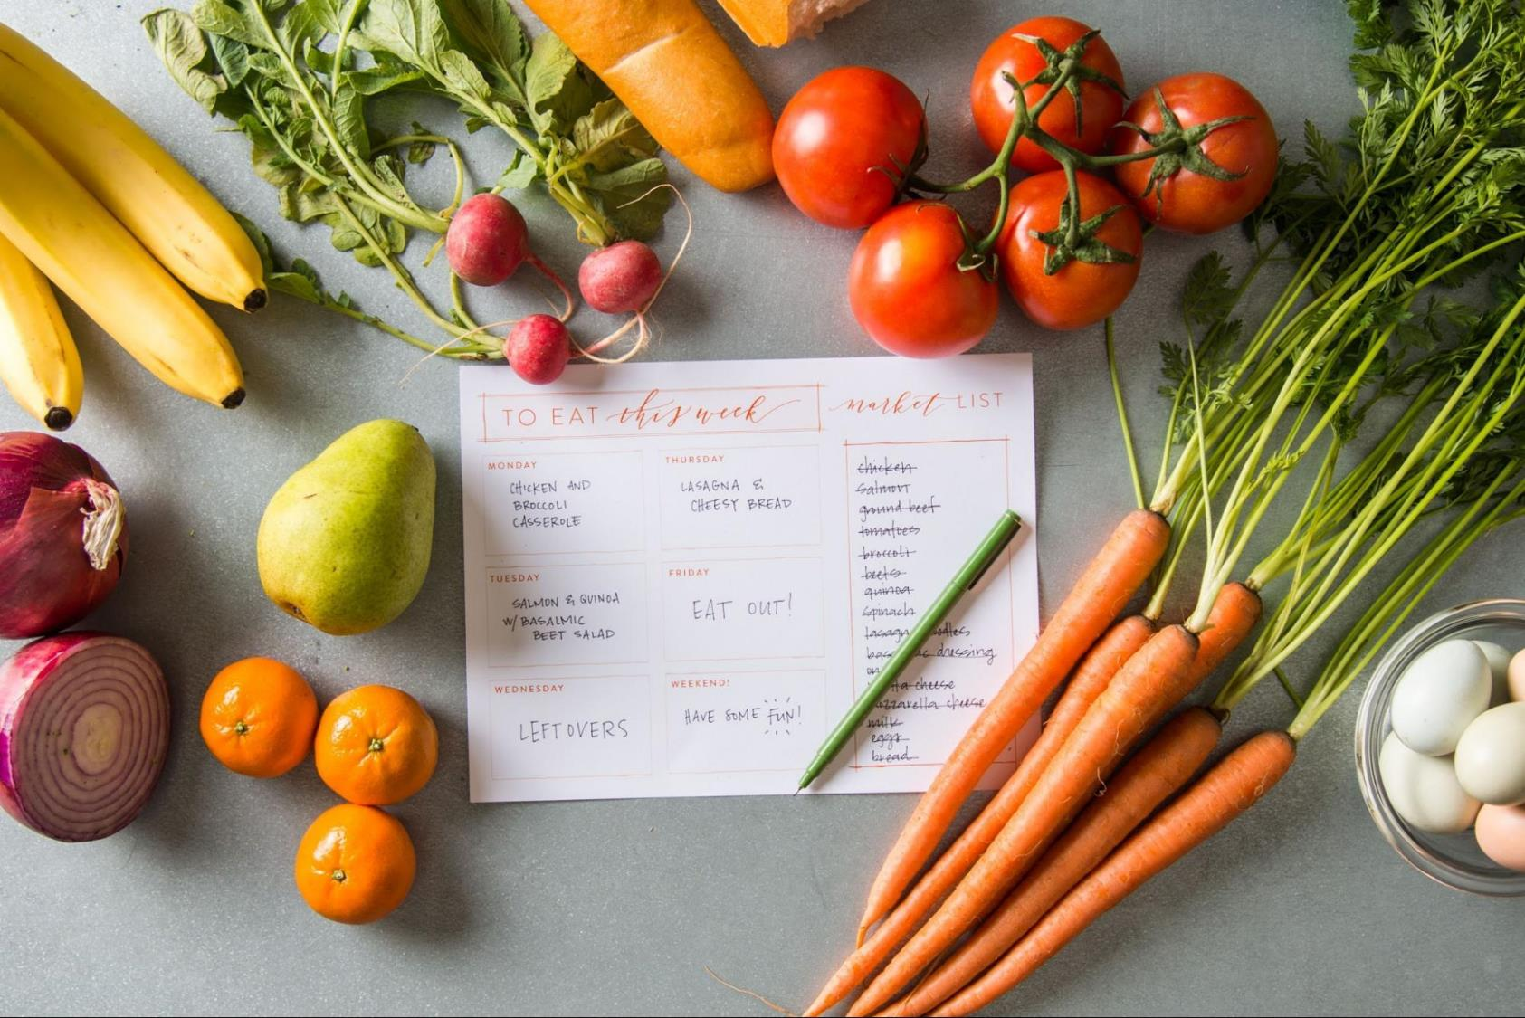
Create a weekly menu and grocery list before shopping.

Slide 34
Properly store, freeze, dry, and preserve perishable foods.

Slide 35
Learn techniques for cooking “nose-to-tail” and “root-to-leaf”.

Slide 36
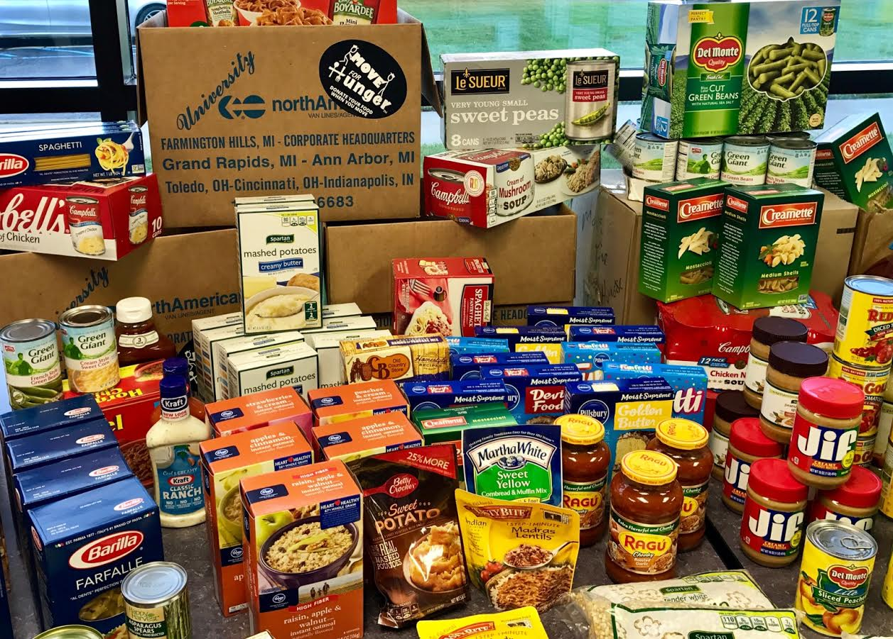
Donate extra food from your pantry and garden.

Slide 37
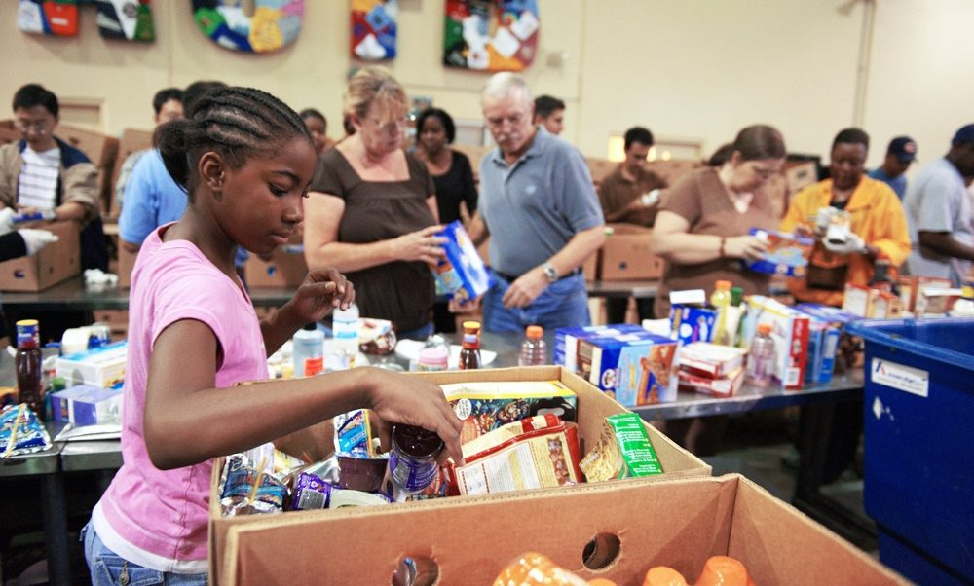
Volunteer at a local food pantry or emergency meal center.

Slide 38
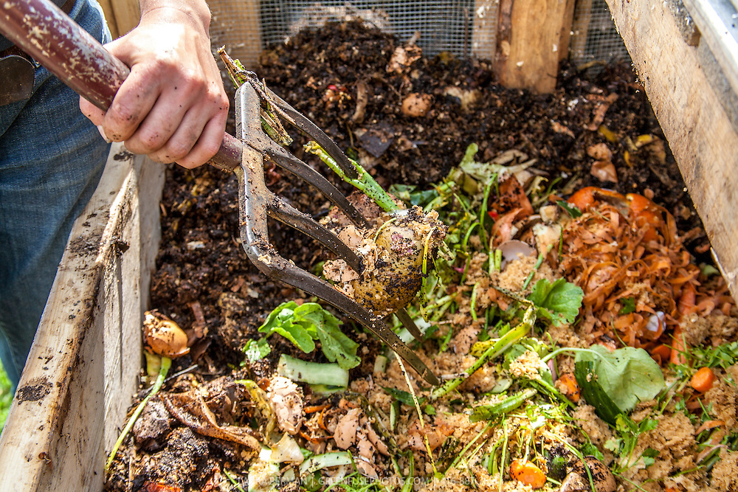
Compost leftover food scraps to create a nutrient-rich soil amendment.

Slide 39
Use compost to regenerate soils and grow nutritious foods.

Slide 40
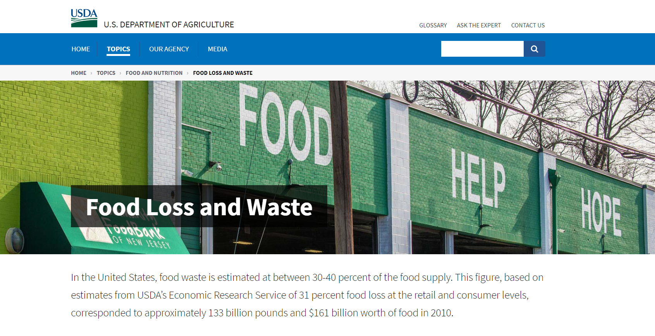

Slide 41
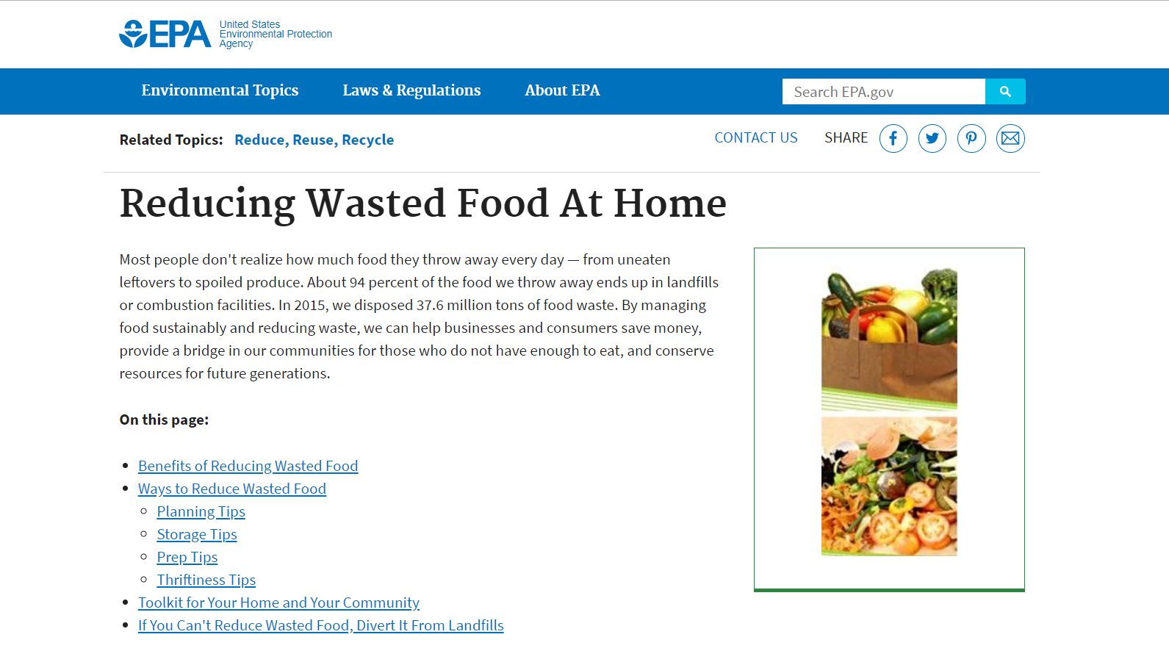

Slide 43
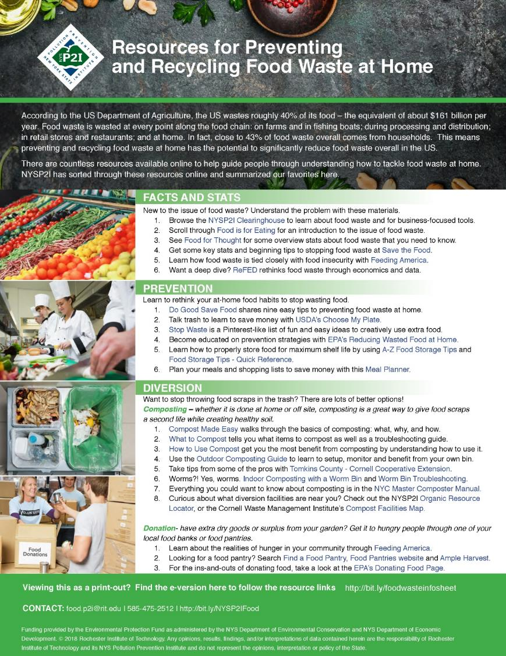

Slide 44
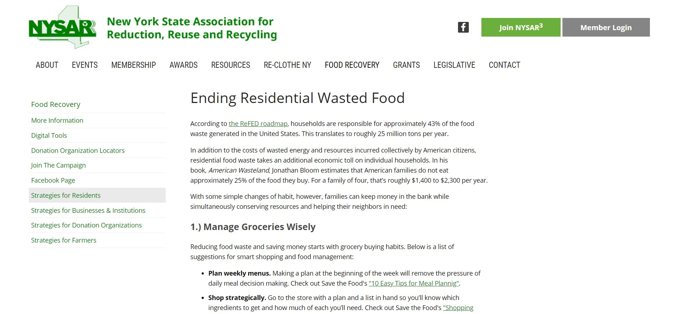

Slide 45
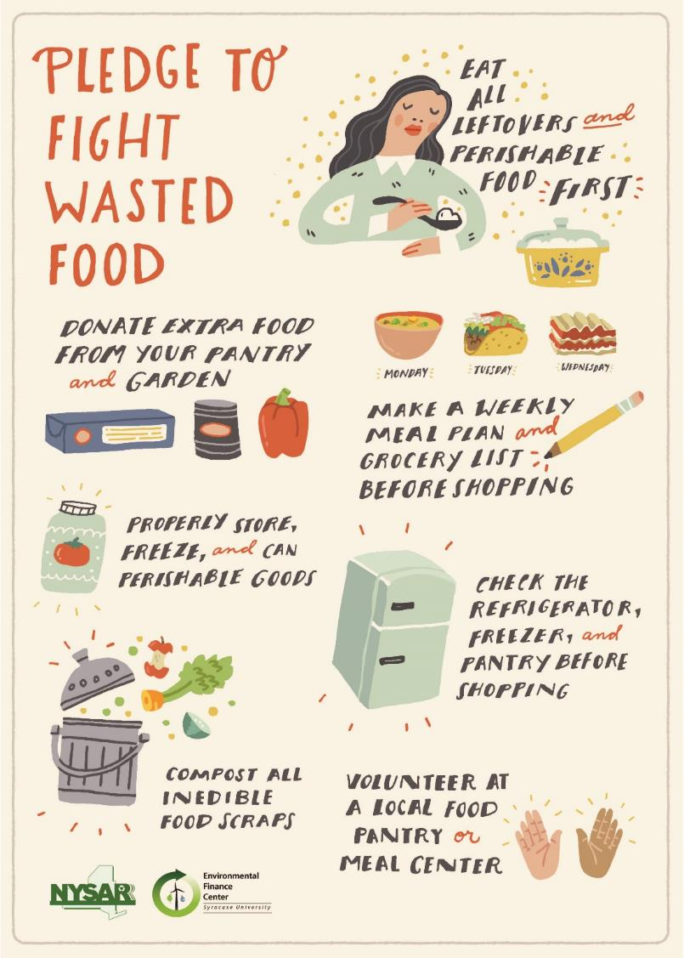

Slide 46
Jesse Kerns Program Coordinator SU-CSCS/EFC jekerns@syr.edu (315) 443-8488
Pledge to reduce wasted food in your home at: http://efc.syr.edu/prevent-wasted-food-pledge/

